Slide 1
TEZOS DEEP DIVE DECK 2.0
(UPDATED NOVEMBER 2021)
Tezos Deep Dive Deck - Licensed under CC BY 4.0 - published by asc(s e.V. , November 2021

Slide 2



Tezos – the Blockchain Solution to Your Real-World Problem!
created by Niko Hildebrand on behalf of asc(s e.V.
This work is subject to the Attribution 4.0 International Creative Commons License
Version 1.x supported by the Tezos Foundation
Notes:
This “pitch deck” is meant to help advance the adoption of Tezos. Its main application its distribution as a means for “self-study”, which makes it necessary for slides to be self-explanatory without an accompanying “audio track”. This is why slides are not as “simple” as might be expected from a pitch deck.
However, the deck can also be used for presentation by hiding some of the more detailed slides. Every detailed slide is also designed in a way that provides in depth textual information but also a visual representation that can be focused on, when using the deck for presentation purposes.
Its target group is:
Technologically affine
Possesses basic previous blockchain knowledge
Is employed in the “old economy” rather than in finance
May be a product owner or similar
Not top management but rather someone who may have a problem in their daily business that might require a blockchain solution
The pitch deck’s goal is:
The target group gets a basic understanding of Tezos’ underlying technology and Tezos’ key features/USPs
The target group realizes that blockchain in general and specifically Tezos may be a solution to their problems/may be a building block of a solution to their problem

Slide 3
Content
The Tezos Deep Dive Deck:
The value proposition
What is blockchain and why do you need it?
Why are public blockchains the future?
Tezos: Interesting aspects of the technology
Tezos: Amendment history
Tezos: Ecosystem overview
Tezos: Application examples
Blockchain MythBusters
References

Slide 4




OUR PROMISE
What you will learn from this slide deck…
You will…
…gain an understanding of what blockchain is, how the technology works and what it is good for!
…learn about the difference between private and public blockchains and why we think that public chains are the future!
…fall in love with Tezos for its superior and upgradeable technology and its great and open community!
…gather knowledge about important blockchain-related concepts such as SSIs and NFTs and their place with Tezos.
…see a blueprint of how to build industrial applications on top of Tezos, streamline consortia and interact with the community.
…enjoy a series of mythbusters about common misconceptions in the blockchain and crypto space!
NFT
SSI

Slide 5
YOU
Let us tell you something about yourself…
You are
technologically affine
…
Your superiors manage things,
but they never really get to the bottom of them…
Maybe you work
in the “old economy”…
You are well-respected and
your opinion counts
in your organization
Your superiors may have heard
of blockchain during the hype…
You probably have at least
a basic understanding of what a blockchain is…
Notes:
This slide is meant to emotionally capture the main target group of the slide deck: technologically affine employees in the „old economy“ who are NOT top-mgmt. BUT carry significant influence due to their excellent reputation.
Make them feel:
proud about themselves (technologically affine, well-respected, your opinion counts, you have at least a basic understanding of blockchain)
misunderstood and a little helpless/miserable about their situation (old economy = nightmare for digital natives, superiors don’t understand/never listen)
Leave slide out of the deck, if presentation context does not fit.

Slide 6
…and what your problem might be…
YOUR
PROBLEM
Your organization operates in an environment, that is characterized by…
…a diverse ecosystem…
…diverging incentives…
…a need for coopetition…
…a long and fragmented
multi-tier supply chain…
…strict regulatory requirements…
You face business challenges,
that are characterized by…
…a lack of trust…
…expensive intermediaries…
… (self-) certification requirements…
…an obligation to provide proof of something
– e.g. conducted validation…
…auditability…
…a need for privacy…
…lacking market transparency…
…the need for tamper-proof immutable documentation…
asc(s e.V.
Notes:
Blockchain technology is often accused of being a „technology searching for its problem“. This slide is meant to address the problem BEFORE presenting a possible solution:
Make the main target group think about their real world problems that might qualify for a solution by blockchain (without them having to know exactly what blockchain is suited for at this point).

Slide 7
WHY BLOCKCHAIN?
Notes:
This is one of the core pitch slides: It opens the first chapter of the storyline „Why blockchain? Why public blockchain? Why Tezos?“

Slide 8

Just a quick reminder – what exactly is a blockchain?
A blockchain is a data structure that groups data (e.g. transactions) into immutable containers called blocks…
…chains them together in an order-preserving way that only allows appending (but not deleting or editing)…
Transaction x
Transaction y
Transaction z
Block
…is replicated limitless times in a distributed (peer-to-peer) network…
…and maintained by a protocol that aligns participants’ incentives in a way that provides protection against fraud and malicious attacks!
Notes:
This slide is meant as a non-technical introduction/recap of what a blockchain is.
It abstracts from conceptual and technical explanations about hashes, consensus algorithms, etc.

Slide 9
Why blockchain could be a building block for your problem‘s solution…
Blockchains are shared and immutable data stores that provide trust in trustless environments!
They allow to save costs and increase process efficiency through disintermediation.
They are operated by distributed peer-to-peer networks
which makes them very reliable as there is no single point of failure.
They can be used to provide transparent documentation
with selective privacy enabling traceability and auditability.
Their combination of immutability and accessibility enables revocable certificates.
Notes:
This is one of the core pitch slides: It gives a summary of the answer to the question why to build an application with a blockchain!
It is the introductory slide of the storyline “Why blockchain? Why public blockchain? Why Tezos?”
The icons are meant as visual „support“ for the main arguments.

Slide 10
Why blockchain could be a building block for your problem‘s solution: Disintermediation
Transactions require two or more parties to fulfill their part of the deal.
In physical transactions, little trust is needed since goods and/or money are exchanged (almost) simultaneously.
In contrast, nonphysical transactions are theoretically prone to fraud as the exchange of goods and/or money happens sequentially.
The traditional solution to this problem is the use of a trusted third party – a so called intermediary – who operates between the transacting parties:
  If the other party doesn’t fulfill their part of the deal, the intermediary does not release your contribution to the transaction to that party.
  All transacting parties can trust the intermediary because he has a strong economic incentive to act honestly as his entire business model depends on his reputation.
Intermediaries cause additional process costs (as they need to be paid for their services) as well as process inefficiencies in form of additional process steps and times.
Blockchain technology allows transacting parties to directly interact with each other by shifting the required trust from the intermediary to the technology – or rather the network maintaining the blockchain – and thus saves costs and allows to realize process potentials. The removal of intermediaries is called disintermediation.
You
✗
✗
✗
Intermediary
costs
Intermediaries
(e.g. banks, notaries, …)
Process
inefficiencies
Your business partners (suppliers, customers, etc.)
Notes:
This is a more detailed explanatory slide that is more suitable for self-study than presentation.
If presented, a focus should be laid on the illustration and explanations be given freely:
What is an intermediary and why is he needed?
Which costs and inefficiencies are caused by using an intermediary?
What is disintermediation and why does blockchain enable it?

Slide 11
Why blockchain could be a building block for your problem‘s solution: No single point of failure
In centralized networks, participants are not directly linked to one another but connect via a central network resource that serves as a data hub.
You may know this pattern from logistics, where such set-ups are called hub-and-spoke networks and the hub serves as a turnover point where goods from various origins are consolidated before jointly transported to their destinations.
While comparatively efficient in various ways, centralized networks have a fatal weakness: if the hub fails, the whole network breaks down, which is why there is a single point of failure.
In contrast, distributed networks are characterized by direct point-to-point (or peer-to-peer) connections between network participants.
There is no direct connection from every participant to every other participant, but since every participant maintains multiple connections, data interchanged between two arbitrary points can be relayed via a multitude of routes.
Distributed networks are thus much more resilient against system breakdowns and data loss as they can even compensate the simultaneous failure of multiple nodes.
As blockchains are maintained by a distributed (peer-to-peer) network where every peer holds a complete copy of the blockchain’s current state, the system has no single point of failure.
Centralized networks with a single point of failure:
Distributed networks with no single point of failure:
✗
✗
✗
Notes:
This is a more detailed explanatory slide that is more suitable for self-study than presentation.
If presented, a focus should be laid on the illustration and explanations be given freely:
What are centralized and distributed networks?
Why is there a single point of failure in centralized networks and none in distributed networks?

Slide 12
Why blockchain could be a building block for your problem‘s solution: Immutability/Traceability
As the name indicates, a blockchain is a data structure that essentially groups data into blocks (e.g. transaction data) which are chained together in a way that preserves chronological order and prevents editing (i.e. manipulating) any data that has entered the blockchain:
  Blocks are timestamped and new blocks of data are always appended at the end (“head”) of the chain.
  A hash function creates a concise representation of the block’s data called hash value often described as the fingerprint of the data as it identifies the data and changes drastically if the input is modified in the slightest way.
  The hash value of the previous block is always included in the calculation of the current block’s hash value, thereby linking the blocks. If data in a previous block were manipulated, this would change its hash representation and thus breaking the chain.
Replicating this special kind of database across the nodes of a Peer-2-Peer-Network (P2P-Network) and finding consensus on its “right” state in an attack resistant way makes the blockchain a practically immutable ledger.
Blockchain solutions are therefore destined for applications that require immutability for traceability/auditability reasons.
These are typically found in environments in which high values are exchanged i.a. with strict regulatory requirements and complex multi-agent ecosystems.
Block n-1
Block n
Block n+1
determines
determines
determines
Hash Value n-2
Hash Value n-1
Hash Value n
determine
determine
determine
Hash Value n-1
Hash Value n
Hash Value n+1
Transaction Data
Transaction Data
Transaction Data
Notes:
This slide gives a detailed explanation of blockchain‘s property of immutability and how it is created.
It‘s a slide mainly serving self-study but can be handy as a back-up slide for less informed audiences.

Slide 13
Why blockchain could be a building block for your problem‘s solution: Revocable certificates
As an immutable, independent and public ledger, a blockchain enables revocable certificates and credentials.
For certificates to have a value, they must be trustworthy.
In particular, it must be (almost) impossible to forge or edit the certificate even for its issuer.
If a credential changes, the existing certificate has to be revoked (i.e. declared invalid) and – if applicable – a new certificate has to be issued.
The blockchain’s immutability makes certificates forgery resistant and – in case of public blockchains – its accessibility enables it to serve as a revocation registry.
To avoid making sensitive information publicly available, the certificate issuer can hand out the certificate to its recipient and just register a hash-representation (a representation, that is unambiguously linked to the original data but is neither human readable nor allows a reproduction of the original data) on the blockchain.
The recipient can present his human readable version of the certificate to any verifier, who can produce the hash-representation and match it with the one found on the blockchain to verify its authenticity and validity.
To revoke a certificate, the issuer references the hash and adds the information that it’s invalid – any future verification then fails.
Issue
Certificate
Register
certificate
Revoke
certificate
Verify certificate
Legend
Issuer
Receiver
Verifier
Notes:
Revocable certificates – while theoretically possible in private settings – make much more sense with public blockchains. However, they still are a general argument for blockchain use and open a whole class of possible applications.

Slide 14
WHY PUBLIC
BLOCKCHAIN?
Notes:
This is one of the core pitch slides: It opens the second chapter of the storyline „Why blockchain? Why public blockchain? Why Tezos?“

Slide 15
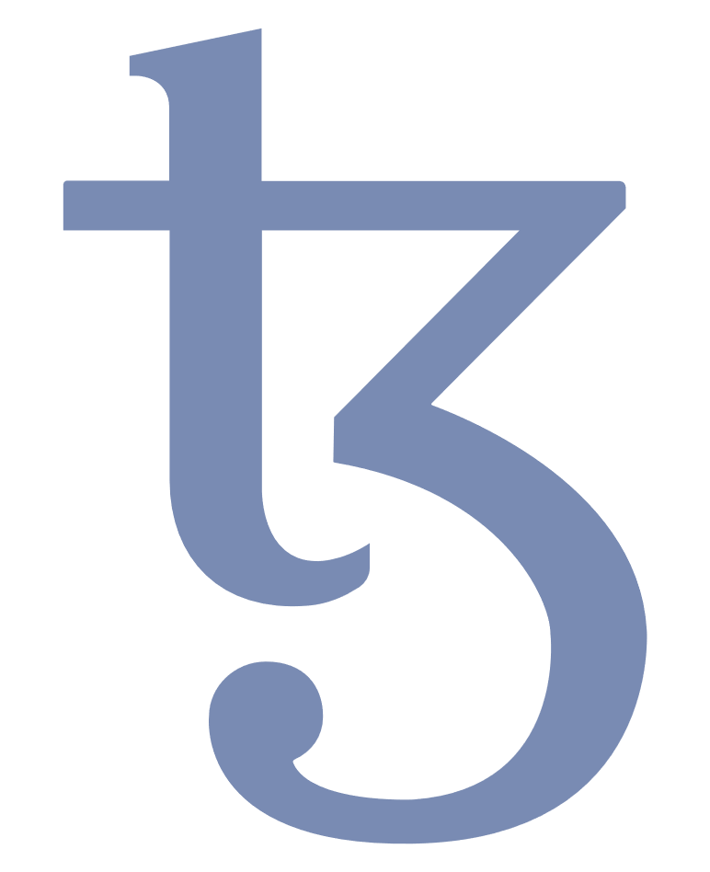
Just a quick reminder – what exactly is a PUBLIC blockchain?
Although every blockchain protocol may have its unique features, there are four archetypes that allow a basic classification along two binary dimensions:
  The public vs. private dimension determines, whether the network is in general open for everyone (→ public) and thus who can read the blockchain and initiate transactions or whether its access in restricted (→ private).
  The permissioned vs. permissionless dimension determines, if every network participant (as allowed by the public vs. private dimension) can take part in the validation of transactions (→ permissionless) or if transaction validation is restricted to a selected subset (→ permissioned).
Public permissionless types are also called “public blockchains”, private permissioned set-ups are called “private blockchains” and public permissioned combinations are known as “consortium blockchains”.
While all types may have their use cases (e.g. private permissionless for voting), private and permissioned blockchains are more centralized (in the sense that they are less decentralized) und thus provide a lower level of security against various attack vectors while being “less immutable”.
Tezos is a public and permissionless blockchain that is open to everyone and only requires bakers (i.e. validators) to hold a minimum stake (i.e. number of tokens).
Permissioned
Only selected network participants can validate transactions
Public Permissioned (“Consortium Blockchain”)
Private Permissioned (“Private Blockchain”)
Centralization
Permissionless
Every network participant can validate transactions
Decentralization
Public Permissionless
(“Public Blockchain”)
Private Permissionless
Public
Everyone can participate in the network, i.e. read the blockchain and initiate transactions
Private
Only selected participants can access the network, i.e. read the blockchain and initiate transactions
Notes:
This slide is meant as an introduction/recap of what a public blockchain is (in contrast to a private blockchain).
This is a more detailed explanatory slide that is more suitable for self-study than presentation.
If presented, a focus should be laid on the illustration and explanations be given freely:
What is the difference between public and private?
What is the difference between permissioned and permissionless?
How is Tezos to be classified?

Slide 16
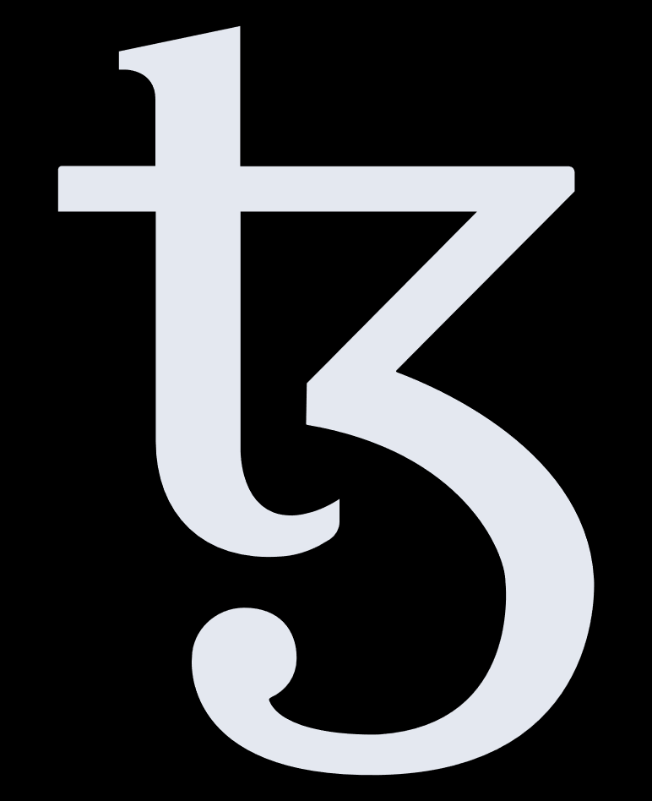
Why public blockchains are the future…
The benefits of closed networks are limited – today’s internet applications wouldn’t be possible if we only had intranets!
The fixed costs of maintaining your own network are higher than (variably) paying for using an existing one,
overall costs for numerous small networks are higher than for one large network!
Public blockchains tap into the wisdom of the crowds and their intrinsic motivation,
while private blockchains are solely developed by paid and thus extrinsic motivated people.
Public blockchains provide much higher immutability/security against manipulation through stronger decentralization!
Alleged USPs of private blockchains (like privacy, scalability) erode with current and further technological
developments (e.g. implemented: privacy with Sapling, under way: Tenderbake, layer 2 optimistic rollups)
PRIVATE
PUBLIC
$
$
$
$
USP
USP
Notes:
This is one of the core pitch slides: It gives a summary of the answer to the question why to build an application with a public blockchain!
It is the second slide of the storyline “Why blockchain? Why public blockchain? Why Tezos?”
The icons are meant as visual „support“ for the main arguments – icons on the left display disadvantages of private blockchains, icons on the right promote public blockchains’ advantages.

Slide 17
Why public blockchains are the future: The internet analogy
In economic theory, there is a big chapter about network effects. It covers everything from decreasing marginal costs through economies of scale to increased individual utility with growing network size.
Imagine a telephone network that consists of only two endpoints. Its users’ benefits would be very limited as they could only call the other endpoint but no one else (for selected use cases – say the “red telephones” between the Pentagon and the Kremlin during the Cuba Crisis – there could still be significant utility).
Now imagine a protocol such as TCP/IP that – in contrast to telephones, which are limited to synchronous verbal communication – allows a multitude of applications such as websites, e-mail, tube video sites, IP telephony, etc.) and the effect multiplies.
You can employ the protocol in a private environment which gets you an intranet, or in a public network which we call the internet. From which use can you extract the most value?
While private enclaves are still necessary e.g. for company internal applications, they now tend to be built as parts of the internet that are shielded from the public through additional privacy and security mechanisms such as VPNs, TLS, etc. with only critical infrastructure remaining truly self-sufficient networks.
With blockchains, it is exact the same: a private blockchain may be adequate for a very specific use case, but public blockchains will generate much more value in the long run.
TCP/IP
Internet
Intranet
VPN, TLS, …
Privacy with Sapling, …
Blockchain
Public
Private
Notes:
While this slide is very text-intensive, the internet analogy is a powerful tool that is easily understood since everyone is by now familiar with the internet.

Slide 18

Why public blockchains are the future: The power of open source technology
In addition to “classical network effects“ such as increasing marginal utility and decreasing marginal costs with a growing network, public blockchains unleash the power of open source technology.
They are developed and maintained by vibrant open source communities that consist of some of the brightest individuals in their fields.
Using a public blockchain thus allows you to:
  Capture the enormous potential and innovation capabilities of intrinsically motivated communities.
  Distribute the burden of development and maintenance costs on multiple shoulders.
  Profit from greater software security because the openly available codebase is not only reviewed by the community itself but also vetted by third parties (like yourself) who wish to build their applications on top of it.
  Concentrate on your use case, the development of the corresponding application and its integration with the blockchain via interfaces.
An important economical aspect, that is not applicable for open source technology in general, but also comes with public blockchains, is that the costs for operating the blockchain are carried by the network: you pay for its use instead of its operation!
Innovation
Bright Minds
Intrinsic Motivation
Open Source Community
Development
Operation
Maintenance
Security
LOWER COSTS
Notes:
As Tezos has a very vibrant and healthy community, the argument of this slide, which generally applies to open source technology is a strong argument for Tezos.
Decision makers who are usually very cost-driven, should recognize that paying for using existing infrastructure is cheaper than maintaining their own infrastructure and that the work of intrinsically motivated people does not only come cheap, but is also of a quality that only passion can produce.
The illustration of the open source community with the light bulbs as a symbol for innovative power and the hearts (coincidentally beating for Tezos) provides a powerful image that should be stressed in presentations.

Slide 19
Why public blockchains are the future: Developments in scaling and privacy technologies
SCALING TECHNOLOGIES
Scalability is one of the major points of concern of public blockchains.
However, several so-called layer 2 solutions (because they add a layer on top of the root blockchain) are currently being developed and tested, in order to solve scalability problems.
One such concept are payment channels (as devised for the Bitcoin Lightning Network) between two transacting parties. For example, implemented as zkChannels by Bold Labs on Tezos.
Optimistic rollups by Marigold are a Layer 2 solution validating transactions on behalf of the main chain. They are “optimistic” based on the assumption that validation is correct until proven otherwise.
PRIVACY TECHNOLOGIES
Developments in privacy technologies diminish concerns about confidentiality on public blockchains.
Zero-knowledge proofs allow to prove a fact without revealing the fact itself, e.g. that a valid transaction has occurred without revealing the transaction (and its details) itself.
Current protocols are zkSNARKs (zero-knowledge succinct non-interactive arguments of knowledge) which require a confidential initial set-up and are used in Zcashs Sapling which has been integrated with the Edo proposal.
Payment Channels
Tree of Rollup Chains
Proof
Multi Signature
Wallet
Rollup Chains
Payment Channel
Secret
Prover
Verifier
The Proof…
…is complete: every true claim will convince an honest verifier
…is sound: a false claim will not convince an honest verifier
…reveals zero knowledge: the proof does not leak the secret
Smart Contract
Tezos Main Chain
Notes:
This slide gives an overview of the two most pressing developments that will mitigate concerns about public blockchains: scaling and privacy technologies!
Decision makers may not be too interested in understanding HOW the mechanisms work but rather THAT they work.
The slide still gives a rough explanation.

Slide 20
An excursion to algorithm theory: Why public blockchains require a coin/token
In order to agree upon “one truth” in the distributed network, a consensus protocol is required.
A consensus algorithm needs to possess the following properties:
  Termination (finality): the algorithm terminates
  Agreement: all nodes agree on the same value
  Validity: the agreed upon value makes sense
In fault-tolerant distributed networks, these properties cannot be achieved simultaneously (FLP impossibility).
By abandoning the termination requirement (finality becomes probabilistic), consensus protocols for blockchains become semi-algorithms, resulting in the possibility of multiple “current state” versions of the blockchain across the network that evolve over time.
In a Sybil attack an attacker exploits this by creating fake nodes that convince the network of a wrong version of the “current state”.
To prevent this, Sybil control mechanisms such as Proof-of-Work (PoW), Proof-of-Stake (PoS), … (PoX) utilize economic incentives to prevent malicious behavior. This is achieved by the use of a coin (crypto currency) by:
  rewarding honest behavior (rewards are generated through coin inflation)
  making non-compliant behavior expensive (work/coin collateral).
Due to non-termination, blockchain states evolve across the network:
s₀
s₁
s₂
s₃
s₄
s₅
s₆
node 1
s₁
s₂
s₃
s₄
s₅
s₆
node 5
node 4
s₀
s₁‘
s₂‘
s₃‘
s₄‘
node 2
node 2
node 3
node 3
In a Sybil attack, fake nodes manipulate the „truth“:
fake 1
s₁
s₂
s₃
s₄
s₅
fake 2
fake 3
s₀
s₁‘
s₂‘
s₃‘
fake 4
s₁‘‘
s₂‘‘
s₃‘‘
s₄‘‘
s₅‘‘
s₆‘‘
Sybil control mechanisms (PoX) prevent this through economic incentivisation with a coin:
GOOD TO KNOW
If consensus algorithm Tenderbake is activated, probabilistic finality becomes deterministic finality.
Notes:
This is a more advanced slide inspired by the explanation given by Diego Oliver Fernandez.
It provides detailed insights to they way the network adopts blockchain states and will take some time to digest for people not familiar with distributed networks.
The illustration on the right can serve for explanations in presentations.

Slide 21
WHY TEZOS?
Notes:
This is one of the core pitch slides: It opens the last chapter of the storyline „Why blockchain? Why public blockchain? Why Tezos?“

Slide 22
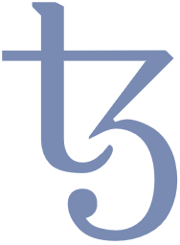
What is Tezos? – A definition by Arthur Breitman, co-founder of Tezos
“Tezos is a technology…
…implemented in a software project
…which allows participation in a peer-to-peer network
…that produces a blockchain
…which maintains a decentralized ledger
…instantiating a cryptocurrency.”
Arthur Breitman
</>
Notes:
This slide is a „playful“ display of Arthur Breitman‘s definition and disambiguation of Tezos.
It is well-suited for pitch presentations and takes more time to think about, that to read or present it.

Slide 23
Why Tezos is the right choice when building your blockchain solution…
Tezos is a public and permissionless blockchain and public blockchains are the future!
Tezos is upgradable through a proven on-chain governance mechanism and thus built to last!
Tezos employs Liquid Proof-of-Stake which is more scalable than Proof-of-Work and does not consume much energy!
Tezos is secure and uses the purpose-built functional language Michelson which allows formal verification of smart contracts!
Tezos is driven by a vibrant and active community with a lot of academic backing!
Powerful features like zkSNARKs for privacy and a Layer 2 solution for further scalability
have been developed and/or are under way!
∞
Notes:
This is one of the core pitch slides: It gives a summary of the answer to the question why to build an application on top of Tezos!
It concludes the storyline “Why blockchain? Why public blockchain? Why Tezos?”
The icons are meant as visual „support“ for the main arguments.

Slide 24
Some KPIs: Tezos in numbers…
June 2018
active
since
> 1,800,000
created
blocks
~ 400
active
validators
> 1,900,000
funded
accounts
~ 5.0%
average
inflation
> $ 4.5 B
market
capitalization
8
successful
amendments
~ 120
transactions
per second
> 135
active
projects
Notes:
Decision makers always want to see KPIs – whether they know how to interpret them or not.
This slide is thus well-suited for real pitch situations: it’s got a clean design and it provides numbers.
KPI sources were:
30-40 TX/s (https://learn.tqtezos.com/files/proofofstake.html#consensus)
https://tzstats.com/
https://www.tezos.help/#projects

Slide 25
Some KPIs: Growth in Smart Contract Calls
GOOD TO KNOW
Growth of contract calls by a factor 38 within 9 months.
Reduction of gas costs by factor 4 through Granada Update.
Thanks to a growing number of applications and falling gas fees due to protocol upgrades, there has been a massive and continuing growth in smart contract calls on Tezos in 2021 proving that the chain is very much alive and being used!

Slide 26
Key Feature: The amendment process/on-chain governance makes Tezos future-proof
The intrinsic dilemma of blockchains so far:
So far, every new blockchain project tried to solve one or two “problems“ of previous blockchains.
But nobody is omniscient and there are still major advances in virtually every aspect of the technology.
So by the time a new blockchain goes live, it is already obsolete!
Changes to “classical” blockchains can only be achieved by forks.
Forks do have their raison d'être, but are very hard to coordinate in a truly decentralized ecosystem
and do not favor decisions based on options’ merits.
∞
a structure built to last for eternity
vs.
a very young and immature technology
”everything is set in stone“
“technology still advances in quantum leaps“
Tezos solves this dilemma with a built-in and proven governance mechanism that allows on-chain coordination leading to controlled upgrades to the protocol. The Tezos blockchain can thus evolve over time and adapt the best technological developments
from the entire ecosystem!
Notes:
This is a must slide in the pitch deck. It‘s part of a three-slide series that shares the same layout and explains the key feature of on-chain governance as well as the dilemma it solves!

Slide 27


How the Tezos on-chain governance/amendment process works
The Tezos on-chain governance is implemented in an amendment process, that consists of five major periods, each of which lasts five baking cycles of 8,192 blocks (so 40,960 blocks per period).
Depending on the votes, each period may end by forwarding the process to the next period or by reverting to the process’ outset.
During the Proposal Period, bakers can submit up to 20 proposals by injecting the hash of the amendment’s source code.
If there is no proposal or a tie by the end of the period, the process reverts to its start. Otherwise, the proposal with the majority of votes proceeds to the Exploration Vote Period.
Bakers can then vote, whether they wish the previously selected proposal to proceed to the Cooldown Period, which happens, if both a dynamically determined quorum which is calculated as a function of the previous quorum is met and a supermajority of initially ≥ 80% is reached. Otherwise, the process is reset.
During the Cooldown Period, bakers and community members can and should test the amended protocol (outside the mainnet).
The Promotion Vote Period follows without another vote but is concluded by the final vote of whether the amendment should be adopted. If the quorum is met and a supermajority reached, the amendment will be activated on the main chain following the Adoption Period that serves as a buffer for the ecosystem to adapt to the new protocol version. Either after the Adoption period or if the proposal is not successful in the Promotion Vote Period, the process starts again with the next Proposal Period.
Every period lasts 5 baking cycles consisting of 8192 blocks.
#
Proposal Period
No proposal or
tie between proposals
<SOURCE CODE>
#
Development
Team
Baker
#
Proposal with
most votes
Voting rights are assigned to bakers based on the number of rolls in their staking balance:
1 vote = 1 roll = 8,000 ꜩ
Exploration Vote Period
Quorum not met or <80% vote Yay
Activation & New Governance Cycle
Quorum met
+ ≥80% vote Yay
Cooldown Period
Testing Period
Finished
Adoption Period
Quorum met
+ ≥80% vote Yay
Promotion Vote Period
Quorum:
$Q_{t+1}=0.8⋅Q_{t}+0.2⋅q_{t}$
$Q_{t}:quorum in t$
$q_{t}:actual participation in t$
Q
Attention: Tenderbake consensus algorithm currently in testing stage will remove the roll system.
Notes:
This slide gives a detailed explanation of the on-chain governance mechanism. The graphic on the right side is a textbook style illustration and should provide a good overview that can also be used in presentations.

Slide 28
What is the difference between forks and the on-chain governance?
Soft Fork
Hard Fork
On-Chain Governance
Legend
Blocks before upgrade
following old rules
Blocks from upgraded nodes
following new rules
Blocks from non-upgraded
nodes violating new rules
Blocks from non-upgraded
nodes not violating new rules
Legend
Blocks from non-upgraded
nodes following old rules
Blocks from upgraded nodes
following new rules
Legend
Blocks following old rules
Blocks following new rules
A soft fork is a backward compatible change of the protocol adopted by a willing subset of nodes.
Changes in the protocol restrict the protocol rules, so “old” nodes will accept blocks adhering to the new rules.
Only a subset of blocks created by “old” nodes will be accepted by the network, as some will break the now stricter rules.
A hard fork is a change of the protocol that is not backwards compatible.
Changes in the protocol allow blocks that were not allowed before, so “old” nodes will not accept blocks adhering to the new rules, effectively splitting the network.
This duplicates the coins, dividing their value between the “old” and “new” currency, and nodes will switch to the version they think will be adopted by the majority.
With the on-chain governance, a new version of the protocol is activated by all nodes, replacing the previous protocol.
With the controlled governance mechanism, protocol options are evaluated based on merits rather than herd behavior.
A “duplication” of currency is avoided, thereby preserving its value.
There are scenarios/situations in which forks still make sense (e.g. emergency bugfixes), but with on-chain governance, they are not necessary for protocol evolution, making them very rare.
Notes:
„There will always be hard-forks!“
This slide explains the difference between a fork and the on-chain governance mechanism. It also points out, that hard-forks might still occur and that there may be legitimate reasons for them.
It makes for a good back-up slide in presentations and is well-suited for self-study.
If presented, it should be stressed that hard-forks become much less probable with the on-chain governance.

Slide 29
Key Feature: Liquid Proof-of-Stake makes Tezos secure without wasting energy
Bitcoin’s intrinsic dilemma:
If an attacker controlled more than half of the network he would be able to “convince” the network of his “truth”.
He could thus reverse transactions by rewriting the blockchain history and double spend his money.
This type of attack is called 51%-attack or Sybil attack* as the attacker creates a lot of fake nodes to gain control.
Bitcoin seeks to prevent 51%-attacks by making them very costly.
This is achieved through the Sybil control mechanism Proof-of-Work (PoW) that requires a Bitcoin miner (i.e. validator) to prove
that he invested a lot of work by solving a cryptographic puzzle which consumes a lot of computing power and consequently energy.
GOOD TO KNOW
network security
vs.
energy consumption
196 TWh in
November 2021
https://digiconomist.net/bitcoin-energy-consumption
”Bitcoin mining is needed to prevent 51%-attacks“
“Bitcoin mining consumes more energy than Thailand“
Tezos solves this dilemma with a different kind of Sybil control mechanism called Liquid Proof-of-Stake. Like in PoW, Bakers (i.e. validators) are extrinsically incentivized through rewards but energy consumption is avoided by a security deposit, that can be slashed.
* Named after Sybil Dorsett who suffered from dissociative personality disorder
Notes:
This is a must slide in the pitch deck. It‘s part of a three-slide series that shares the same layout and explains the key feature Liquid Proof-of-Stake as well as the dilemma it solves!

Slide 30
How Liquid Proof-of-Stake (LPoS) works
The top design priority for Liquid Proof-of-Stake (LPoS) is security by true decentralization.
While a worrying degree of concentration can be observed with mining pools for Bitcoin’s Proof-of-Work (PoW) and delegated Proof-of-Stake (dPoS) as utilized in EOS and Lisk operates with a fixed and limited validator set, Tezos’ LPoS strives for low entry barriers for validators (called bakers in Tezos).
Baking requires downloading the baking/endorsing node, holding a roll (8,000 ꜩ) as well as modest computing power and a reliable internet connection.
Delegation is optional for token holders and bakers compete for delegations with the proportion of earnings they share with their delegators, their reputation and individual terms & conditions.
The number of delegations a baker can accept is limited by his self-bond (approx. 10-times its own stake).
Bakers are randomly selected for block creation and endorsement, with a probability depending on the represented stake. They commit a security deposit for block creation and endorsements proportional to the potential gains which can be slashed in case of misbehavior.
The baker receives a reward and including transaction fees for creating a block as well as for each of the 256 possible endorsements. Rewards and deposits are released after approx. 5 cycles and delegators are paid their share.
A proportion of the rewards according to the individual baker’s terms & conditions is paid out to delegators
Token holders delegate validation rights to a baker of their choice
Delegated stake
Delegated stake
Bakers compete for delegations along
Fees
Payout frequencies
Reputation
…
Baker’s own stake ≥ 8,000 ꜩ
Baker’s own stake ≥ 8,000 ꜩ
Bakers are randomly selected for block creation and endorsement, probability depends on represented stake
Bakers must commit a security deposit for baking and endorsing that is slashed in case of double-baking/double-signing
The selected baker creates (bakes) the block and earns a reward along with transaction fees contained in the block (rewards and deposits are released after approx. 5 cycles)
Up to 256 bakers sign (endorse) the block and earn a reward as well (rewards and deposits are released after approx. 5 cycles)
GOOD TO KNOW
If Tenderbake is adopted the number of endorsements will change but the overall inflation of 5% will remain.
Notes:
It might be worthwhile stretching the graphic explanation of LPoS on the right on to a whole slide to make it optically more appealing and more presentable.
Apart from that, this slide offers a good overview of how LPoS works.

Slide 31

Tez – the Tezos coin and its functions
CANNOT BE DELEGATED
FINANCIAL OWNERSHIP
CAN BE
DELEGATED
VALIDATION
VOTING
Notes:
This slide gives a compact overview of the Tezzies’ functions and their ability to be delegated:
Financial Ownership (cannot be delegated): Ownership and thus financial payment function. (Remark: For Germany there is the KWG law (“Kreditwesengesetz”/”German Banking Act”) – in this context it is probably relevant, that financial ownership is not delegated to the baker so that the baker does not have custody of the coin and is thus not BaFin regulated. However, Unity cannot give binding legal advice - consult your lawyer for legal certainty!).
Validation (can be delegated): Awards validation rights to bakers on a probabilistic basis that corresponds to the represented amount of coins.
Voting (can be delegated): Grants voting rights in the on-chain governance process in proportion to represented amount of coins.

Slide 32
Key Feature: Formally verifiable smart contracts
The smart contract dilemma:
Smart contracts are simple computer programs that can automatically be executed, when certain conditions are met.
They are deployed on the blockchain and thus both accessible and immutable.
Smart contracts can be used to automate the execution of the conditions of legal contracts and thus automate inter-party processes.
However, when engaging in a smart contract, there are two problems:
First, smart contracts are programmed by humans and humans make errors, so is the smart contract doing what it should be?
Second, the smart contract’s compiled version deployed on the blockchain is not human readable, so is it doing what its author claims?
process automation
vs.
process integrity
✓
”smart contracts can automate inter-party processes“
“is the smart contract doing what it should?“
Tezos solves this dilemma with smart contracts in the custom-made, formally verifiable language Michelson and a certified compiler. The first minimizes the probability of errors as formal correctness can be proven, the latter allows to analyze the human-comprehensible version, compiling it oneself using the certified compiler and then comparing the result to the deployed version.
Notes:
This is a must slide in the pitch deck. It‘s part of a three-slide series that shares the same layout and explains the key feature of formally verifiable smart contracts as well as the dilemma it solves!

Slide 33
The main design goals for the Michelson virtual machine were readability, security and efficiency
Virtual machines that allow the execution of smart contracts are attack vectors for blockchains.
Bugs caused by smart contracts that are known from other blockchains are:
  Overflow (Multiple)
  Reentrance bugs (Ethereum DAO hack)
  Absence of libraries (Parity)
  Combination of imperfect features (Parity)
  Honeypots
All these bugs were possible due to design failures. The Michelson VM was custom-made to avoid bugs and allow formal verification (mathematical proof).
Next to security, the Michelson design goals were:
  Readability: an expressive representation of the smart contract on the blockchain.
  Efficiency: allowing fast contract execution and making the calculation of gas costs as easy as possible.
Michelson is a statically typed stack language without variables but with high-level primitives (arbitrary length integers, maps, sets, lambdas and crypto primitives: hash, check signature).
 | EVM | WASM | Michelson
Properties | 256 integers | 32/64 integers | Infinite precision integers
 | No data structures | No data structures | Persistent sets, maps, lists
 | Side effects | Side effects | No side effects
 | Purpose made | Standard | Purpose made
Platform | Ethereum | Dfinity, EOS | Tezos
EVM = Ethereum Virtual Machine
WASM = Web Assembly
“Business logic, not protein folding.”
Arthur Breitman
(about the purpose of smart contracts in Tezos)
Notes:
This slide details the design goals of Michelson and compares Michelson to other VMs.
If used for presentation, the main goals should be stressed:
Security
Readability
Efficiency
Arthur Breitman‘s statement is a nice anchor that can be used to elaborate what smart contracts are for in Tezos and how this sets Tezos apart from competing paradigms.

Slide 34


Smart contracts in high-level languages can be compiled to Michelson
Michelson is a compromise between the design goal of efficiency with respect to gas accounting that would suggest an assembly-like language on the one hand and security and readability that would suggest a high-level functional language on the other hand.
There are high-level languages such as SmartPy, LIGO (and more, e.g. Haskell derivatives) that can be compiled to Michelson.
This allows to program smart contracts in a way that comes more natural to most programmers, e.g. LIGO offers different syntaxes that are designed to resemble Pascal (PascaLIGO), Ocaml (CameLIGO) and ReasonML (ReasonLIGO).
It also allows people who want to engage with a smart contract deployed on Tezos to read and understand what the contract does (its “terms”).
To verify, that the deployed contract on the chain and the high-level language contract offered for inspection are indeed equivalent, a certified compiler can be used: it guarantees that the third party gets the same result when compiling the high-level code and can compare it to the low-level code on the chain.
Smart contracts in Michelson can be formally verified using test frameworks like Mi-Cho-Coq (https://www.springerprofessional.de/making-tezos-smart-contracts-more-reliable-with-coq/18522634)
Smart Contract in
(.py file)
or
(.ligo file)
or
Other high-level language (e.g. Haskell derivatives)
high-level code
Compiler
Decompiler
Smart Contract in Michelson
(.tz file)
low-level code
Notes:
This slide provides some more insights into Michelson and how it relates to high-level languages.
The SmartPy and LIGO logos are linked to their respective websites.

Slide 35
The Tezos consensus algorithm: Emmy / Emmy+ since Babylon / Emmy* since Granada
Because they are closely entwined, Sybil control mechanisms like Proof-of-Work (PoW) or Proof-of-Stake (PoS) are often confused with consensus algorithms. However, they are merely mechanisms to protect the consensus protocol against Sybil attacks.
The consensus algorithm is needed for the network to agree upon a “common version of the truth” (i.e. the right chain). It is mainly characterized by the question of how the right chain is determined.
There are two main types of consensus protocols:
  Nakamoto Consensus: the longest/heaviest/fittest chain is the canonical one (probabilistic finality).
  Byzantine Fault Tolerant Consensus: the latest block with more than 2/3 of the validator set’s signatures is appended (deterministic finality): Tenderbake.
Bitcoin’s consensus protocol uses Nakamoto Consensus with the longest chain criterion as the longest chain has consumed the most work – which shows how consensus protocol and Sybil control mechanism are mutually dependent.
The Tezos consensus protocol is called Emmy and since the Babylon amendment the refined version Emmy+ is in place which was replaced with Emmy* (with the goal of providing faster finality without compromising security), with the activation of Granada.
Emmy* uses Nakamoto Consensus with the fittest chain criterion where fitness is determined by the number of endorsements (signatures from endorsing validators) contained in the chain. Up to 256 bakers (validators) can endorse a block (only 32 with Emmy+).
Fitness:
931
Fitness:
980
Fitness:
1024
4
163
4’
212
4’’
256
GOOD TO KNOW
3
256
Emmy+ has a minimum block delay of 60s and requires 6 confirmations to achieve reasonable finality assuming a Byzantine attacker with a stake fraction of 33%:
6 * 60s = 6mins
Emmy* has a minimum block delay of 30s and requires only 2 confirmations under the same assumptions:
2 * 30s = 1 min
Emmy* thus speeds up finality by a factor of 6!
2
209
2’
256
1
256
Legend
0
1
256
Block number
Number of endorsements
Notes:
Although it is not so much a key feature that sets Tezos apart from other blockchains, the way consensus on chain state is achieved is still one of the most important aspects of a blockchain protocol and should thus be made transparent.

Slide 36
Tezos utilizes two types of consensus for different purposes
Consensus on chain state
Achieved through
consensus mechanism
Emmy*
Consensus on technology evolution
Achieved through
on-chain governance/
amendment process
(“change management”)
Necessary preconditions:
“Healthy” network, i.e. diverse validator set
Low entry barriers for new bakers
Sybil control mechanism (LPoS)
Implications:
Secure consensus on canonical chain
Necessary preconditions:
Tools
Discussion forums
Transparency
Communication
Participation
Rigorous test framework
Implications:
Community can vote on developments that you do not favor
Drastic reduction of hard fork probability
No „asset duplication problem“ through hard forks (see NFTs !)
Notes:
This slide disentangles two different types of consensus that are required in the Tezos universe and achieved through different mechanisms.
It‘s not critical to the storyline but makes for a nice addition.

Slide 37
Is there a development roadmap for Tezos?
For people or organizations thinking of building applications on top of Tezos, it is of course of interest which developments can be expected in the future.
As Tezos is a truly decentralized project, there is no central governing body that decides on its development, so there is no roadmap as such.
Developments are implemented through the amendment process and thus governed by the community through on-chain governance.
However, no development simply materializes out of nowhere. All the greater developments are discussed in the community – good sources are: Tezos Agora Forum, TZIP, Nomadic Labs Announcements
Some of the developments that can be expected in the future are:
  Introduction of an alternative BFT-style consensus algorithm: Tenderbake
  Layer 2 scalability solutions with optimistic rollups.
  Baking accounts (to enable bakers to rotate their keys without losing their delegations)
  Improvements to the amendment process itself (e.g. privacy-preserving amendment procedures)
Notes:
A development roadmap is something decision makers will be very interested in for two reasons:
Because they will require a certain level of stability to feel „safe“.
Because they will want to know which technological advancements/developments may be expected in the near future when comparing their options.
It is important for them to understand, that there is not central authority in Tezos who decides on and dictates a roadmap. However, it is also important for them to see, that there is still some kind of a horizon of what can be expected.

Slide 38
TEZOS
AMENDMENT HISTORY

Slide 39
The self-amendment process works: 8 successful amendments and counting… (1/3)
The self-amendment process through Tezos’ on-chain governance works!
So far, there have been 8 amendments that went live after the proposals successfully ran through the voting process and update number 9 with the letter “I” is already under way.
Tezos Agora (agora like the central festival, assembly and market- place of cities in ancient Greece) allows to:
  Browse all periods that occurred so far with respect to proposals, their description, voting outcomes, etc.
  Discuss current and future proposals in the Tezos Agora Forum.
One proposal that got voted to the Exploration Period, Brest A, did not make it to the Testing Period, reverting the process to Proposal.
The amendments contain a multitude of changes like new features, housekeeping/bugfixes and performance updates as well as amendments to the existing ruleset, including the amendment process itself.
A
05/30/2019
thens
Participation: 84.35 %
In Favor: 99.89 %
Increase gas limit per block, reduce roll size from 10,000 ꜩ to 8,000 ꜩ
B
10/18/2019
abylon
Participation: 83.46 %
In Favor: 84.53 %
Emmy+, delegable tz1 addresses, Michelson upgrades, hardened governance
C
03/05/2020
arthage
Participation: 72.05 %
In Favor: 99.61 %
Increase gas limit per block and operation, improve formula for baking and endorsing rewards
Legend
Date of Activation
KPIs from Promotion Period
Description of Amendment
Notes:
The on-chain governance is one of the USPs that set Tezos apart.
The six activated amendments to the Tezos protocol prove that the mechanism works.
Decision makers will want an overview of the amendment history so far.

Slide 40
The self-amendment process works: 8 successful amendments and counting… (2/3)
Until Edo was activated, a period within the amendment process took 8 baking cycles with a cycle consisting of 4,096 blocks. As blocktime varies slightly but has a lower bound of 1 minute, a period used to take at least 22.76 days or roughly 3 weeks.
Accordingly, a full iteration of the amendment process used to take at least 91.02 days or roughly 13 weeks / 3 months.
However, the fifth & sixth updates – Edo and Florence – brought about some significant changes to the amendment process itself:
  The fifth period called the Adoption period was introduced to give bakers, indexers and end users a sufficient time window to update and adapt to the new protocol version. (Edo)
  Period lengths were reduced from 8 to 5 cycles, shortening the minimum time between updates to 25 cycles taking at least 71.11 days or roughly 10 weeks / 2.5 months. (Edo)
  No test chain is created within the mainnet anymore and the Testing period has been rechristened to Cooldown period accordingly. (Florence)
D
11/12/2020
elphi
Participation: 68.49 %
In Favor: 100.00 %
Reduce gas costs, reduce storage costs, fix bugs, code cleanup and refactoring, improve Michelson safety
E
02/13/2021
do
Participation: 63.91 %
In Favor: 100.00 %
Sapling for privacy preserving transactions, Michelson opcodes, tickets, Adoption period, reduction of periods to 5 cycles
F
05/11/2021
lorence
Participation: 59.61 %
In Favor: 100.00 %
Incr. max. operation size to 32kB, reduce gas consumption, intercontract calls depth first, Cooldown period without test chain
Legend
Date of Activation
KPIs from Promotion Period
Description of Amendment
Notes:
The on-chain governance is one of the USPs that set Tezos apart.
The six activated amendments to the Tezos protocol prove that the mechanism works.
Decision makers will want an overview of the amendment history so far.

Slide 41
The self-amendment process works: 8 successful amendments and counting… (3/3)
The Tezos community follows the convention of naming amendment proposals with city names in alphabetical order. With the last successfully activated proposal being Hangzhou, the next proposal currently within development is named after a city starting with “I”: the test net is called Idiazabalnet.
The voting mechanism of the Tezos On-Chain Governance reveal the voting behavior of all its participants. There is ongoing research in partnership with INRIA to introduce privacy preserving voting mechanisms. More information can be read in: Possible evolutions of the voting system in Tezos.
The features of the next protocol upgrade are as always not fixed but can be predicted by participating in the discussions of the before mentioned social platforms and by analyzing the test networks.
With the possible introduction of the new consensus algorithm Tenderbake not only evolution of the consensus mechanism is shown as with Emmy -> Emmy* but a revolution with the chain from Nakamoto to BFT consensus.
G
06/08/2021
ranada
Participation: 68.60 %
In Favor: 99.59 %
Reduce blocktime to 30s, decrease time to finality by a factor of 6, gas improvements by factor ~ 4, liquidity baking for tzBTC
H
03/12/2021
angzhou
Participation: 67.14 %
In Favor: 99.39 %
Add timelock opcodes to counter MEV, introduce On-Chain Views, add global constants, add smart contract cache
I
April 2022 ?
… ?
Participation: ?
In Favor: ?
Tenderbake ?
Legend
Date of Activation
KPIs from Promotion Period
Description of Amendment
Notes:
The on-chain governance is one of the USPs that set Tezos apart.
The six activated amendments to the Tezos protocol prove that the mechanism works.
Decision makers will want an overview of the amendment history so far.

Slide 42
Athens – the first amendment to the Tezos protocol
Athens is the first successful amendment to the Tezos protocol through the on-chain governance mechanism.
The proposal was developed and brought forward by Nomadic Labs in the 10th period and activated on 2019-05-30.
Its main goal was to introduce a sensible yet simple amendment in order to prove the on-chain governance mechanism’s viability.
With Athens A and Athens B, two different proposals entered the Proposal Period, Athens B proposing a subset of Athens A’s changes:
  Athens A: Increase the gas limit per block and reduce the roll size from 10,000 ꜩ to 8,000 ꜩ.
  Athens B: Increase the gas limit per block.
Gas is a measure for the computation power needed to validate a block, so the increase of the limit allows more computation steps.
A roll is the minimum amount of ꜩ a Baker must hold in order to bake (i.e. validate blocks).
With a majority of 70.3% of votes, Athens A proceeded to the Exploration Period, got voted to the Testing Period and was finally activated on 2019-05-30 after receiving 99.89% of the votes at a participation rate of 84.35% in the Promotion Period.
Nomadic Labs included a symbolic invoice of 100 ꜩ in their proposal as an example for funding proposal development.
Reduction of the roll size from 10,000 ꜩ to 8,000 ꜩ
Increase of the gas limit
Notes:
This slide gives a more detailed explanation of the Athens amendment and is better suited for self-study but could be handy as a back-up slide in presentations.

Slide 43
Babylon – the second amendment to the Tezos protocol
Babylon is the second successful amendment to the Tezos protocol through the on-chain governance mechanism.
It was the first amendment that introduced a significant set of new features and thus proved, that the amendment process not only worked (as shown by Athens) but that amendments to large parts of the codebase are feasible.
Babylon is thus a cornerstone for Tezos to become a blockchain that evolves over time and adapts the best technologies from the entire ecosystem.
It was jointly developed by Nomadic Labs and Cryptium Labs with contributions from Marigold and invoiced with 500 ꜩ.
Babylon brought the following changes:
  An upgrade of the consensus algorithm Emmy to the more robust version Emmy+.
  A quorum floor was set at 20% and a quorum cap at 70%.
  A proposal now requires a minimum of 5% support to proceed to the Exploration Period.
  Introduction of a clear distinction between delegable tz1, tz2 and tz3 accounts and KT1 accounts for smart contracts.
  New Michelson features such as the possibility for multiple multiple big_maps and entrypoints to assist smart contract developers and designers of higher-level languages.
Emmy
Emmy+
Upgrade of the consensus algorithm
Quorum
0%
Floor 20%
Cap 70%
100%
Introduction of quorum floor and cap at 20% and 70%
5%
Proposal Period
Exploration Period
Introduction of a 5% hurdle for proposals
delegate
delegate
KT1
tz
KT1
tz
tz
Account overhaul
New Michelson features (e.g. multiple big_maps and entrypoints)
Notes:
This slide gives a more detailed explanation of the Babylon amendment and is better suited for self-study but could be handy as a back-up slide in presentations.

Slide 44
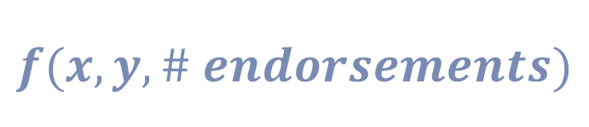
Carthage – the third amendment to the Tezos protocol
Carthage is the third successful amendment to the Tezos protocol through the on-chain governance mechanism and was activated on 2020-03-05.
It was jointly developed by Nomadic Labs and Cryptium Labs and did not contain an invoice.
The proposal was nicknamed the housekeeping proposal as it focused on code clean-up, optimizations and minor fixes instead of introducing significant new features.
Noteworthy changes brought in with Carthage are:
  Increase of the gas limit per operation from 800,000 to 1,040,000.
  Increase of the gas limit per block from 8,000,000 to 10,400,000.
  Adaption of the formula for calculating baking and endorsing rewards to be linear in the number of endorsements (replacing a step function) and to be more resistant to certain types of attacks.
  Minor improvements to Michelson.
Increase of the gas limit per operation to 1,040,000
Increase of the gas limit per block to 10,400,000
$$f(x,y, \# endorsements)$$
Adaption of the reward calculation formula
Improvements to Michelson
Notes:
This slide gives a more detailed explanation of the Carthage amendment and is better suited for self-study but could be handy as a back-up slide in presentations.

Slide 45

Delphi – the fourth amendment to the Tezos protocol
Delphi is the fourth successful amendment to the Tezos protocol through the on-chain governance mechanism and was activated on 2020-11-12.
Originally planned as a major feature upgrade, Delphi instead became an interim protocol proposal focused on performance and gas improvements in order to enable novel applications on Tezos that target areas like DeFi, collectibles, and gaming while features like Sapling, baking accounts, etc. were not ready for deployment.
It was jointly developed by Nomadic Labs, Metastate, and Gabriel Alfour, did not contain an invoice and was proposed after seven governance periods without proposals.
Noteworthy changes brought in with Delphi are:
  Gas changes based on performance improvements increasing the amount of computation per unit of gas while maintaining the current gas limits (Tezos’ low gas costs have since become a significant competitive advantage when compared to other smart contract platforms like Ethereum and have inspired some great memes that were rewarded within the CRP).
  Lowered storage costs (proportional amount of ꜩ burned when increasing the size of the data stored in the state) by a factor of 4 from 1 ꜩ per kB to 0.25 ꜩ per kB.
  Bugfixes, most prominent among them the restoration of compatibility with 32-bit systems.
  General code cleanup and refactoring
Increased amount of computation per unit of gas
Lowered storage costs
û
32-bit
ü
32-bit
ü
64-bit
ü
64-bit
Compatibility with 32-bit systems

Slide 46




Edo – the fifth amendment to the Tezos protocol
Edo is the fifth successful amendment to the Tezos protocol through the on-chain governance mechanism and was activated on 2021-02-13.
Edo was packed with new features and an update to the amendment process itself.
It was jointly developed by Nomadic Labs, Marigold, and Metastate, did not contain an invoice and was proposed in the period directly following the activation of Delphi.
Noteworthy changes brought in with Edo are:
  Integration of Sapling to enable privacy preserving transactions (protocol enabling privacy preserving transactions of fungible tokens in a decentralised environment) and addition of Michelson opcodes for the pairing-friendly elliptic curve BLS12-381.
  Introduction of Tickets as a mechanism for smart contracts to grant portable permissions to other smart contracts or issue tokens.
  Introduction of a fifth period, the Adoption period, to the amendment process and reduction of period lengths from 8 to 5 cycles (shorting the minimum time for a governance iteration from 32 to 25 cycles while simultaneously providing more time to adopt an update after the community’s decision on the update is final).
  Addition of some new instructions to Michelson, including LEVEL to query the level of the current block.
diversified addresses
shielded pool
spending key
shielded tx
shielded tx
viewing key
shielded tx
proving key
Privacy-preserving transactions (Sapling)
creating contract
amount
value
Tickets
Proposal Period
Exploration Vote Period
Testing (Cooldown) Period
Promotion Vote Period
NEW
Adoption Period
û
û
û
û
û
û
û
û
û
û
û
û
Adoption period and reduction of cycles per period

Slide 47

Florence – the sixth amendment to the Tezos protocol
Florence is the sixth successful amendment to the Tezos protocol through the on-chain governance mechanism and was activated on 2021-05-11.
There were two versions of the proposal: One containing Baking Accounts and one identical to the first minus the Baking Accounts. The community followed the developers’ recommendation in voting for the proposal without Baking Accounts due to some concerns about breaking changes that had not been resolved at the time.
It was the first update to go through the new Adoption period and jointly developed by Nomadic Labs, Marigold, DaiLambda, Tarides, and the external contractor Keefer Tyler who was rewarded with the proposal’s invoice of 100 ꜩ.
Noteworthy changes brought in with Florence are:
  Increase of the maximum operation size from 16 to 32 kB allowing for more complicated applications by (more than) doubling the maximum size of a smart contract.
  Further gas consumption optimization to bring down costs even more by increasing efficiency.
  Depth first execution order for smart contract calls (instead of breadth first) making intercontract calls more intuitive.
  Elimination of the test chain in the third period of the governance cycle (and rechristening of the period from Testing period to Cooldown period).
16 kB
32 kB
Increasing the maximum operation size to 32 kB
0
Breadth first
0
Depth first
1
2
1
4
3
4
5
6
7
2
3
5
6
7
Depth first execution order
Proposal Period
Exploration Vote Period
Cooldown Period
Promotion Vote Period
Adoption Period
û
Testnet Fork
Elimination of the test chain

Slide 48

Granada – the seventh amendment to the Tezos protocol
Granada was the seventh successful amendment to the Tezos protocol through the on-chain governance mechanism and was activated on 2021-08-06.
It was jointly developed by Nomadic Labs, Marigold, TQ, DaiLambda, and Tarides.
Noteworthy changes brought in with Granada:
  An overhaul of the current consensus algorithm Emmy+ with Emmy* which will bring down blocktime to approx. 30 s (effectively halving the time between blocks).
  Liquidity baking as a means to enhance liquidity by piggybacking off the liquidity and global availability of Bitcoin.
  Significant gas improvements that will further decrease gas consumption by factors of 3 to 6 and even 8 in some cases.
Emmy+
Emmy*
~60s blocktime
~30s blocktime
Upgrade of the consensus algorithm
tez
tzBTC
Liquidity baking
Gas improvements

Slide 49







Hangzhou – the eighth amendment to the Tezos protocol
Hangzhou is the eighth successful amendment to the Tezos protocol through the on-chain governance mechanism currently in adoption phase and will be activated on 2021-12-03.
It was jointly developed by Nomadic Labs, Marigold, DaiLambda, Oxhead Alpha and Tarides.
Noteworthy changes that will be brought in with Hangzhou are:
  Liquidity baking is extended approx. until the end of the next protocol amendment phase.
  Gas improvements and general gas cost adjustments.
  Context Storage Flattening : a new, more performant data schema for the ledger state resulting in 78% faster I/O. The explosive growth in overall contract calls and NFTs on Tezos means that the size of context is constantly growing.
  Smart Contract Context Cache: in-memory context providing fast access to the most recently used values reducing gas consumption.
  Global Constants: users can use constants to originate larger contracts, as well as share code between them.
  Michelson On-Chain Views: read-only contract storage access is synchronously available on the stack with a new instruction set.
78% faster IO
Context Storage Flattening
fast in-memory access
Smart Contract Context Cache
Shared Global Constants
read only
Michelson On-Chain Views
tez
tzBTC
Liquidity baking extended
Gas improvements

Slide 50
TEZOS
ECOSYSTEM & HISTORY

Slide 51
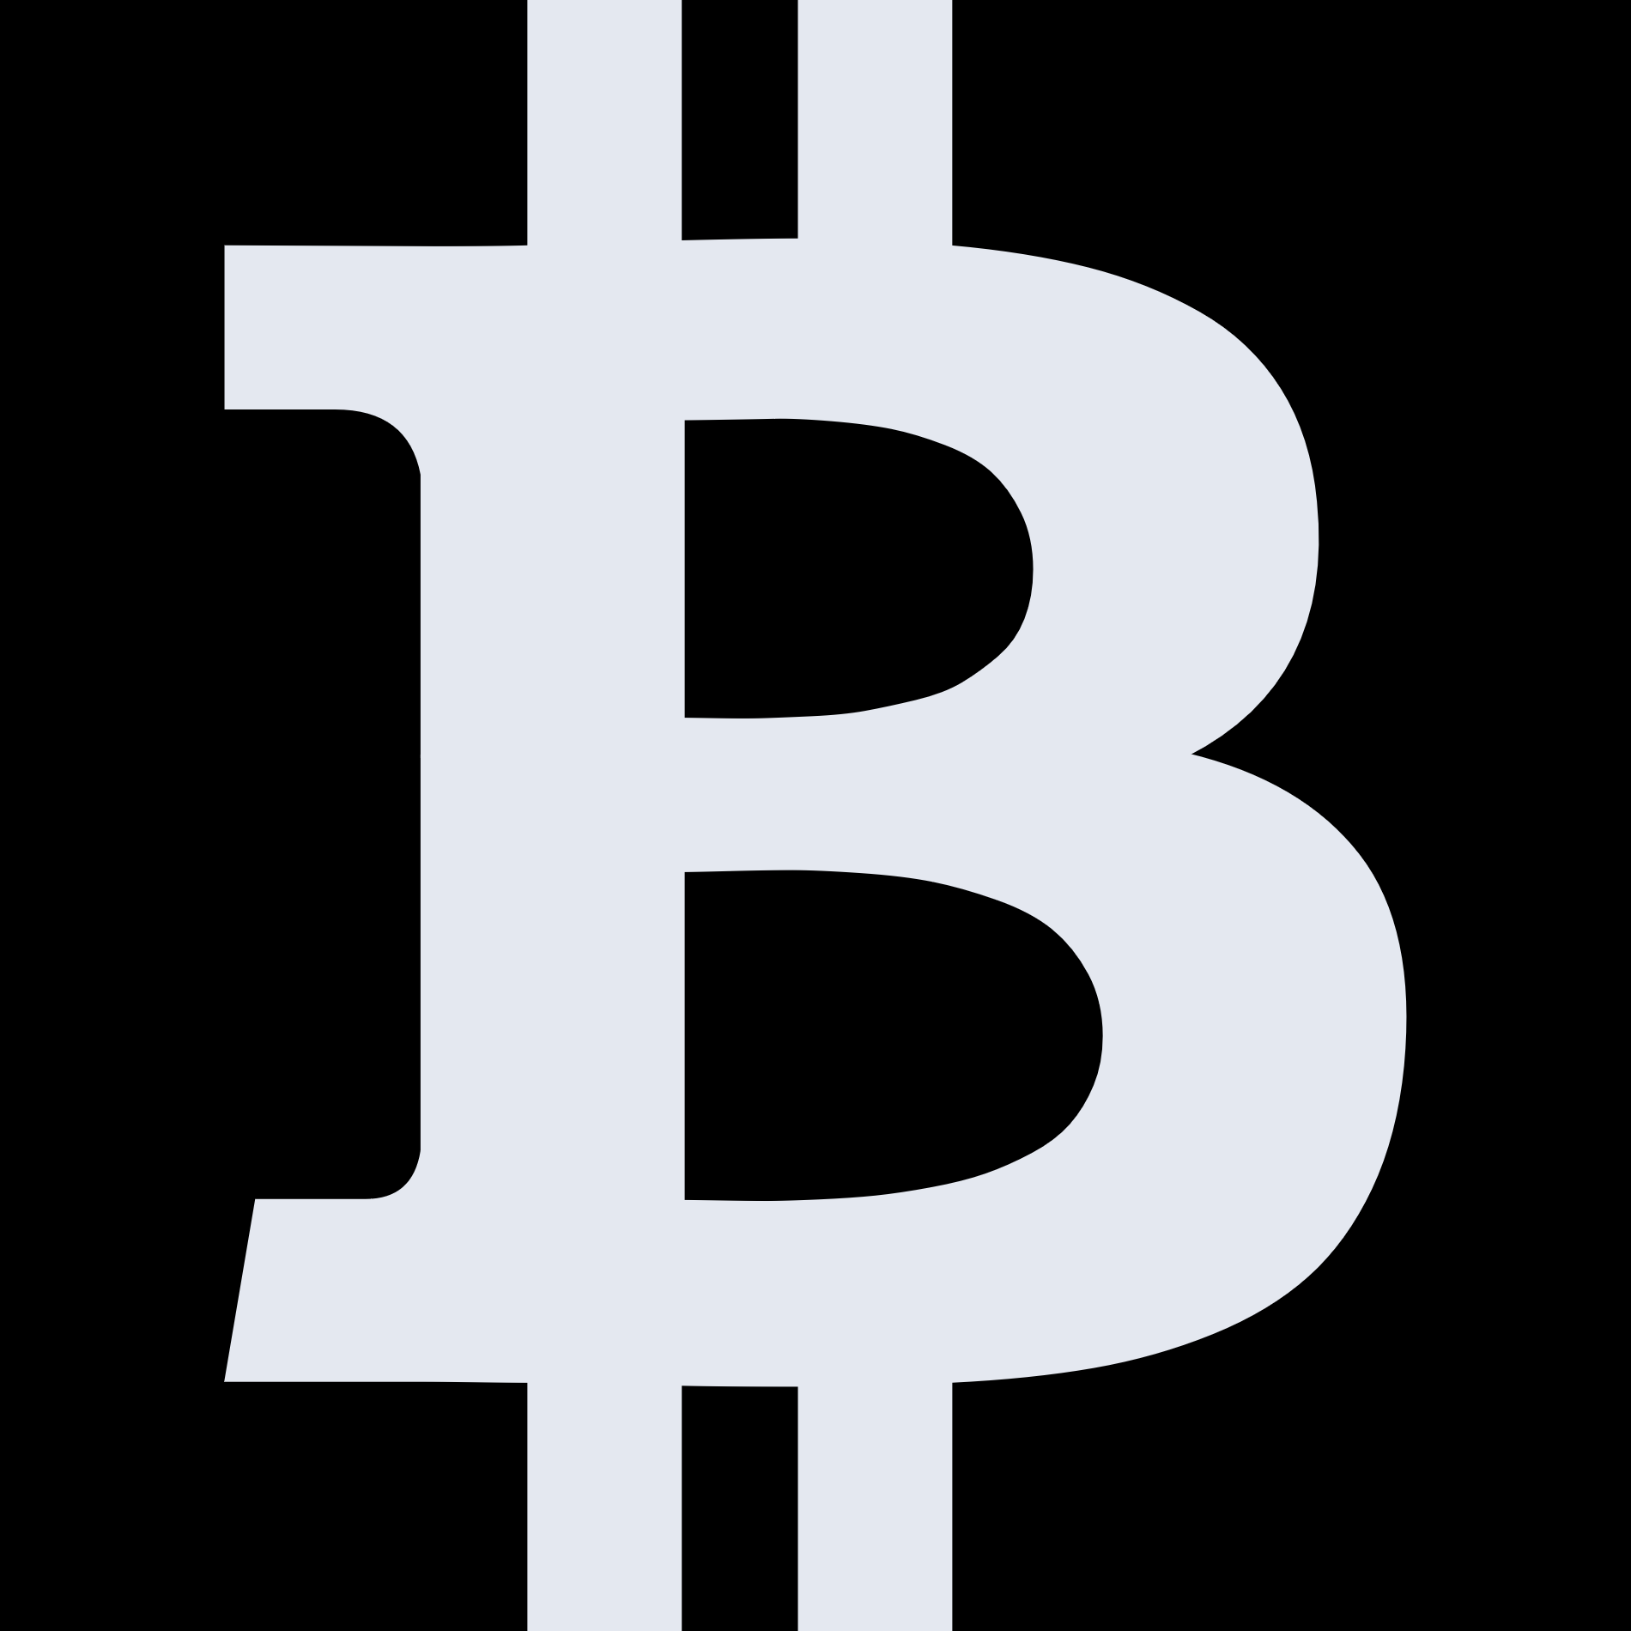
The Tezos ecosystem unraveled: the different roles and actors that constitute Tezos
Strong Informal Community
Token Holders
Projects
Validators/Bakers
Documentation/
Education
</>
Development Teams
Wallet
Block Explorers
Protocol
Community
Foundations/Organizations
Application
Wallets
Coin Exchanges
Notes:
This slide gives a general overview of roles in the Tezos ecosystem.
Most bubbles contain links where more information is available.
The Tezos Foundation is NOT placed in the slides center on purpose to emphasize the decentral nature of the ecosystem.

Slide 52
What is the Tezos foundation and what is its mission?
Our Vision
We seek to empower persons and entities from all over the world to create a robust and decentralized digital commonwealth.
Tezos is a distributed, peer-to-peer, permissionless network. No single entity owns, manages, or controls “Tezos.” Understanding this paradigm is fundamental to understanding Tezos.
Our Mission
We believe Tezos will fuel social, political, and economic innovation on a global scale. Our core mission is to support the Tezos protocol and ecosystem in service of this goal.
As highlighted in the Tezos position paper, the success of any decentralized network is determined by the efforts of a robust, diverse, and flourishing community.
Our Strategy
We deploy resources to help facilitate the advancement of the Tezos protocol and growth of the Tezos ecosystem.
Tezos’ potential rests in the hands of its community, and we have no doubt that the Tezos community is among the strongest and most exceptional in the cryptocurrency ecosystem.
Notes:
This slide allows a brief presentation of the Tezos Foundation and its purpose.
Vision, Mission and Strategy as well as the contents of the speech bubbles are cited from the foundation‘s website.
The Tezos whitepaper is linked just as it is on the website and the Tezos Foundation logo is linked as well.

Slide 53
A brief history of Tezos and the Tezos foundation (1/3)
August 2014
April 2017
Release of the position paper
The Tezos foundation is chartered in Zug, Switzerland
September 2014
July 2017
Release of the white paper
In a fundraiser, > 31,000 wallets are created and > 65,000 bitcoin as well as > 360,000 ether are raised
Fall 2014
First prototype of the network shell
June 2018
August 2015
The betanet is launched
Arthur and Kathleen Breitman found Dynamic Ledger Solutions to support the projects’ development
February 2019
Elevated Returns announces to offer compliant tokenized real-estate offerings based on Tezos
September 2016
May 2019
The source code is published on Github
Athens – the first amendment to the Tezos protocol – is activated
February 2017
June 2019
The alphanet is launched
Release of the FA1.2 token standard
Notes:
This slide gives a brief summary of the history of Tezos and the Tezos Foundation.
Its contents are derived from the history page of the Tezos Foundation‘s website which is linked to the „history book“.
The amendments Athens, Babylon and Carthage were not listed on the history page but make a fitting addition to the timeline.

Slide 54
A brief history of Tezos and the Tezos foundation (2/3)
October 2019
October 2020
Babylon – the second amendment to the Tezos protocol – is activated
EDF group joins the Tezos ecosystem as a validator
January 2020
November 2020
Release of the FA2 token standard
Delphi – the fourth amendment to the Tezos protocol – is activated
March 2020
February 2021
Carthage – the third amendment to the Tezos protocol – is activated
Edo – the fifth amendment to the Tezos protocol – is activated
July 2020
March 2021
Banco BTG Pactual S.A. and Dalma Capital announce plans to utilize Tezos for STOs
Groupe Casino retail group announces the creation of the Euro Stablecoin Lugh based on Tezos
August 2020
Logical Pictures announces EUR 100 million STO on Tezos
April 2021
Ubisoft joins the Tezos ecosystem as a validator
October 2020
April 2021
Introduction of the Tezos Community Rewards Program
Société Générale issues first structured product as a Security Token on Tezos
Notes:
This slide gives a brief summary of the history of Tezos and the Tezos Foundation.
Its contents are derived from the history page of the Tezos Foundation‘s website which is linked to the „history book“.
The amendments Athens, Babylon and Carthage were not listed on the history page but make a fitting addition to the timeline.

Slide 55
A brief history of Tezos and the Tezos foundation (3/3)
May 2021
June 2021
Florence – the sixth amendment to the Tezos protocol – is activated
Announcement of Interpop’s NFT trading card game and comic Book Emergents
May 2021
Tezos-based Hic et Nunc becomes the NFT platform with the largest number of transactions
July 2021
Granada – the seventh amendment to the Tezos protocol was activated
May 2021
October 2021
A partnership with RedBull Racing is announced
The Rarible Protocol & Adobe's Behance Set incorporate Tezos
May 2021
November 2021
Announcement of OneOf music NFT marketplace
New Cambridge-built Carbon Credit Marketplace, Nov 2021
June 2021
Art Basel in Miami Beach to host first 'interactive' NFT exhibition in new collaboration on Tezos
A partnership with McLaren Racing is announced
Red Bull & McLaren Racing debut with Tezos NFTs and multi year partnerships.
Notes:
This slide gives a brief summary of the history of Tezos and the Tezos Foundation.
Its contents are derived from the history page of the Tezos Foundation‘s website which is linked to the „history book“.
The amendments Athens, Babylon and Carthage were not listed on the history page but make a fitting addition to the timeline.

Slide 56
To support the advancement of the Tezos ecosystem, the foundation awards grants
Areas of interest that may be eligible for funding through grants by the Tezos Foundation and information on the evaluation process can be found on the Tezos Foundation’s website:
Process:
  Application and initial vetting by contributors from the Tezos ecosystem.
  Technical Due Diligence by the Tezos Foundation’s Technical Advisory Committee (TAC)
  Final Decision by the Executive Committee or the Tezos Foundation Council
  Communication of final decision and completion of necessary formalities.
Areas of Interest:
  Baking → Target List
  Developer Experience → Target List
  Education and Training → Target List
  End-User Applications → Target List
  Privacy → Target List
  Security → Target List
  Other
To apply for a grant, use the Tezos Foundations Grant proposal website.
G R A N T M A K I N G P H I L O S O P H Y
As the steward of the funds gathered during the donation period, we support groups in the Tezos ecosystem that actively work to advance the project in a variety of ways. Grants offer a strategic way to support other stakeholders and community members, such as educational and research institutions, developers, and enthusiasts from all over the world as they work to advance the project.
Notes:
The prospect of winning a grant may encourage decision makers to engage with Tezos and thus justifies is place in the pitch deck.
The right side is linked to the Tezos Foundation‘s website.

Slide 57



Tezos Community Rewards
The Tezos Community Rewards Program (CRP) is an evolving rewards program that aims to incentivize active community participation by rewarding exceptional contributions to the Tezos ecosystem along an evolving list of award categories.
The CRP was announced in September 2020 and first rewards have been distributed to community members for contributions made in October 2020 where there were already 220 submissions of nominees.
With a funding of 5,000 ꜩ per month, provided to a multisig contract by the Tezos Foundation, the program is run by Tezos Commons through reviewing nominations, selecting winners and distributing the rewards.
Community members are nominated by fellow community members for their contributions in one or multiple award categories within the month the reward is paid for through using an online form to provide contact information, category for nomination, and evidence of the nominee’s contributions.
The total reward pool is split among winners along the various categories where most categories can have up to three winners (more in selected categories) with some categories having a ranking of winners while others split the rewards evenly between all winners.
The reward winners selected by the Tezos Commons judges for factors such as quality and quantity of submissions and activity, and verifiable proof of activity done by the nominee, need to claim their rewards within 72 hours and receive the reward via DirectAuth/ Kukai Wallet (unclaimed or unused rewards are rolled back into the overall pot that is used to fund the CRP).
Unclaimed/
unused
rewards
5,000 ꜩ/month
Community
Tezos Community Reward Program
CRP multisig wallet
…
…
Indive Dev of the Month
Monthly
nomi-
nations
Memenator
Troll Hunter and/or FUD Fighter
Selection of winners
per category
&
Distribution to
Kukai wallets
…
Give and Go
Humble Coder Abode
…
Reward Winners
Notes:
Sources:
https://tezoscommons.org/rewards/ (Tezos Commons Website with links to latest reward winners and nomination form)
https://tezos.foundation/an-update-on-community-engagement/ (Article on Tezos Foundation website from 09/22/2020 announcing the CRP)
https://medium.com/tezoscommons/community-rewards-for-tezos-contributors-d6e2813a83d8 (Medium article introducing and explaining the CRP)
https://medium.com/tezoscommons/tezos-community-rewards-winners-october-2020-7d1b8f520033 (Announcement of October 2020 winners)
https://medium.com/tezoscommons/tezos-community-rewards-winners-november-2020-b228fe054ae2 (Announcement of November 2020 winners)
https://medium.com/tezoscommons/tezos-community-rewards-winners-december-2020-eb46ee7af519 (Announcement of December 2020 winners)
https://medium.com/tezoscommons/tezos-community-reward-winners-january-2021-66a1e8e22d43 (Announcement of January 2021 winners)
https://medium.com/tezoscommons/tezos-community-reward-winners-february-2021-6fc3dd75e250 (Announcement of February 2021 winners)
https://medium.com/tezoscommons/tezos-community-reward-winners-march-2021-76f51cdc333f (Announcement of March 2021 winners)
https://medium.com/tezoscommons/tezos-community-reward-winners-april-2e6c2a066048 (Announcement of April 2021 winners)
https://medium.com/tezoscommons/tezos-community-reward-winners-may-2021-a1f60900816a (Announcement of May 2021 winners)

Slide 58
NON-FUNGIBLE TOKENS
ON TEZOS

Slide 59
Of Tokens and Fungibility: What are NFTs?
A token is a digital representation of an asset or utility.
Depending on its use, a token may be classified as a currency, utility, security/equity, reward or asset token and require corresponding properties.
The property of fungibility is a fundamental characteristic to distinguish token types:
  Fungible tokens are interchangeable, meaning that there are multiple instances of the same token that are not distinguishable, e.g. crypto currencies, voting tokens, staking tokens, etc.
  Non-fungible tokens (NFTs) are not interchangeable, meaning that they are unique and they are indivisible, e.g. digital art, etc.
While a token automatically becomes non-fungible when it’s transferability is restricted, NFTs can also be (and often are) transferable: It makes sense to tie a token’s existence to its owner in case of badges, academic certificates, etc. while the value of NFTs representing art, game items, etc. is derived from their tradeability.
Owning an NFT does not usually go along with owning the copyright of the underlying asset in a legal sense, so the creator of a piece of art can still create copies of (or even destroy) it.
Just like it is the case with crypto currencies, an NFT does not have an intrinsic value. The value is created by the people attributing a value to and willing to pay for it.
NFTs can be held in wallet applications in the same way that you hold fungible tokens like crypto currencies.
Fungible Tokens
(interchangeable; identical value)
Non-Fungible Tokens (NFTs)
(not interchangeable; unique)
Typical applications/use cases:
Crypto currencies, voting tokens, staking tokens
Typical applications/use cases:
Digital representations of art, music, film, collectibles, items in digital games, certificates in academia, badges
Transferable NFTs
(tradeable )
Non-transferable NFTs
(tied to their owner)

Slide 60


NFTs on Tezos: The FA2 token standard
Basically, a token is nothing more or less than a smart contract and theoretically, everyone could use the Tezos blockchain as a platform on which to create arbitrary tokens.
However, in order for the token to work within the ecosystem, it makes sense to abide by a common standard that determines a unified interface, possible token types, and standardizes permissions.
To that end, the token standard FA2 (“financial application”) has been developed for the Tezos ecosystem and introduced with TZIP12.
FA2 is agnostic to token type (allows fungible, non-fungible tokens, non-transferable, and multi-asset tokens) and allows both single and multi-token contracts via one standard API. It standardizes:
  Transfer semantics
  Metadata
  Accessing balances
  Total supply
  Permission rights
Permission rights are the rules that determine who can send how many tokens, receive them, and manage tokens for other users. There are three architecture patterns how permission rights can be done:
  Monolith
  Transfer hook to another contract
  Separate wrapper contract
FA2 Standard
Balance between overspecification (surpressing expressivity) and underspecification (undermining standardization)
Allows fungible tokens
(equivalent to ERC-20 on Ethereum)
Allows non-fungible tokens
(equivalent to ERC-721 on Ethereum)
Allows non-transferable tokens
(equivalent to ERC-1238 on Ethereum)
Allows multi-asset contracts
(equivalent to ERC-1151)
Standardizes:
Transfer semantics
Metadata
Accessing balances
Monolith
Wrapper
Total supply
Permission rights
Transfer Hook

Slide 61

NFTs on Tezos: Why choose Tezos?
Clean NFTs
Compared to Bitcoin, Ethereum and other PoW-Blockchains, Tezos has a neglectable carbon footprint thanks to its energy efficient LPoS sybil resistance mechanism.
“I cannot wait to release my first Juicy Drops collection. […] However, I want to be mindful of environmental concerns and accessibility to all of my fans before we go live. Happy to now be working with OneOf, who is addressing both of these issues.”
Doja Cat about Tezos-based OneOf
“What prompted me to look for other platforms and discover Kalamint was first and foremost the huge minting fees on platforms using Ethereum. Using Tezos to tokenise artworks is an undeniable advantage.”
NFT artist MAIKEUL in a Medium interview with Kalamint
“Gas prices from the Ethereum network are not going to stabilize any time soon.”
NFT artist Cripera on a Medium interview with Kalamint
Low Costs
Compared to other Smart Contract platforms like Ethereum, Tezos has an unbeatable cost structure thanks to its scalability and continued efficiency improvements brought about with on-chain governance technology updates.
Fast Transactions
Transactions on Tezos are fast in blockchain dimensions. The update of the consensus algorithm Emmy+ to Emmy* did speed up finality even further
“Tezos has important qualities that can be similarly valued by Ethereum’s standards. High decentralization and thus safe, secure and trustless. Tezos combines that quality with fast transactions and a high TPS (~121).”
Allen Walters on Cryptoslate

Slide 62
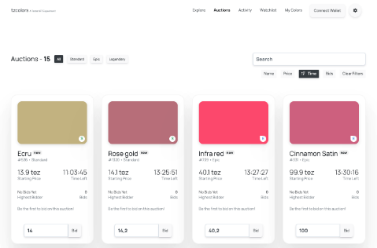

NFTs on Tezos: tzcolors
tzcolors is an experimental project that was conducted to showcase the latest technology available in the Tezos ecosystem: FA2-based NFTs, an auction house contract, Beacon dApp to Wallet communication, and Taquito for contract abstraction in the frontend.
It is an NFT marketplace where a total of 1690 unique colors that were taken from Encycolorpedia can be traded in three categories: Standard (1530), Epic (128) and Legendary (32).
With the launch in February 2021, all colors were immediately available for purchase in initial auctions where the minimum bid was 1 ꜩ.
Auctions last 5 days and are extended by 5 minutes, if a bid is placed during the last five minutes.
All proceeds from the initial auctions are accumulated in the corresponding contract and it is planned that the color owners shall have a say in their use while at least some of them are planned to be given to the developers of the required tooling.
Color owners receive 100% of the proceeds when reselling their color.
Tzcolors supports Temple, Spire, Galleon and Kukai wallets via Beacon integration and color NFTs could be used in future dApps in the Tezos ecosystem as demonstrated by the social experiment TzButton.
As the first NFT application on Tezos, tzcolors has received a lot of attention and close to 10,000 transactions have taken place on tzcolors as of July 2021.

Slide 63
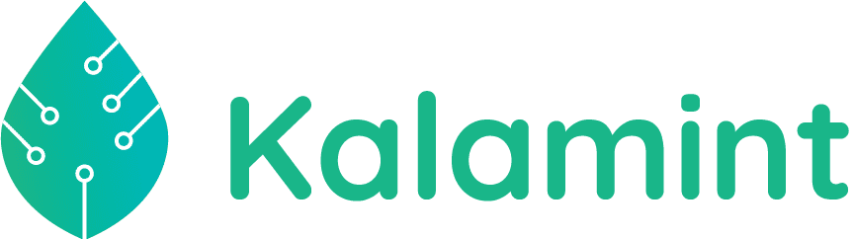
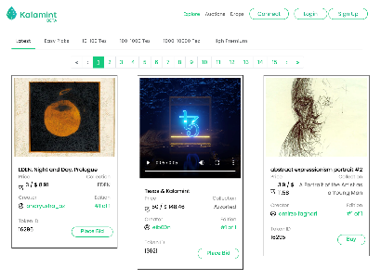
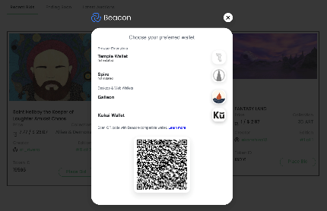
NFTs on Tezos: Kalamint
Kalamint is a marketplace for art NFTs on Tezos and was launched in February 2021.
The platform lets users mint, buy and sell NFTs native to Tezos using the FA2 token standard.
The name Kalamint is derived from the words Kala (representing art in almost all of the languages native to the Indian subcontinent) and Calamint (any aromatic Eurasian plant of the genus Satureja/ Calamintha, having clusters of purple or pink flowers) and meant to represent “art”, “freshness” and “colour”.
Preceeding the mainnet launch, Kalamint was tested on the Tezos testnet from the end of December 2020.
The Kalamint team chose to start with a minimum viable feature set in V1 (mint, buy, sell NFTs based on FA2) and to roll out new features like the creation of collections (limited editions), auctions, price discovery curves and DAO in “baby steps”.
Since then, the team has worked hard and rolled out the promised auction feature in May 2021.
Kalamint also issued the $KALAM token (total supply 1,000,000) which has been used as a reward on the platform (e.g. for early adopters), can be used for liquidity mining/farming, as payment on the platform, for governance and was listed on QUIPUSWAP in June 2021.
Kalamint currently supports the following wallets: Temple, Spire, Galleon and Kukai.

Slide 64

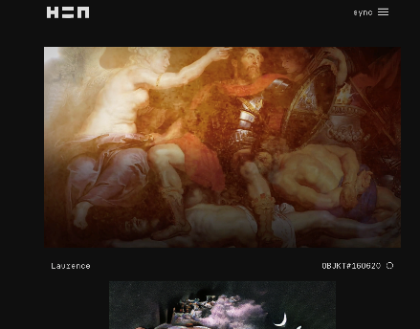
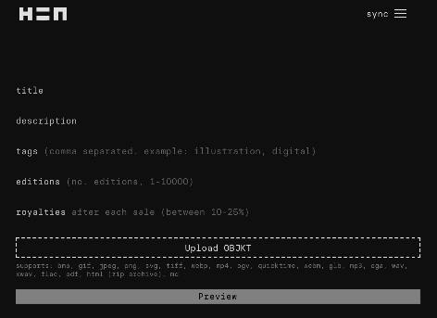
NFTs on Tezos: hic et nunc
hic et nunc (also H=N) is latin for “here and now” and the name of a Tezos-based art NFT platform that was launched (in its alpha phase) on March 1st, 2021. NFTs are called OBJKT on hic et nunc and next to images, hic et nunc also supports interactive and AR NFTS. The project is transforming into a community movement.
From its launch in March to mid-April, hic et nunc distributed its hDAO media governance token (by matching the amount of ꜩ passed from buyer to seller in each transaction and splitting the corresponding hDOA tokens equally among buyer and seller), which can only be bought on Quipuswap since.
Like the NFTs, the hDAO token abides to the flexible FA2 standard. Its total supply is 651,000 and next to the token economics, its use is intended for upvoting OBJKTs (curating) and general governance on the platform.
hic et nunc is very community-driven, invites anyone to contribute and propagates a “NFT Creators Code of Conduct” that appeals to the mintors’ honesty and condemns copyminting (minting someone else’s work without their knowledge and blessing) and reminting (e.g. across different NFT platforms/blockchains).
To celebrate 10,000 minted OBJKTs, on the weekend of March 26th, 2021 with the hashtag #OBJKT4OBJKT users were encouraged by Twitter handle @DiverseNftArt to give NFTs away for free in order for users to build their collections without a cost.
As of July 2021, hic et nunc has seen more than 1,500,000 total transactions and 22,000 total users and supports Temple, Spire, Galleon and Kukai wallet via Beacon integration.

Slide 65
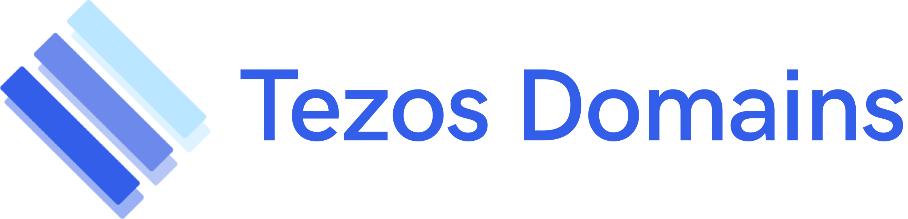
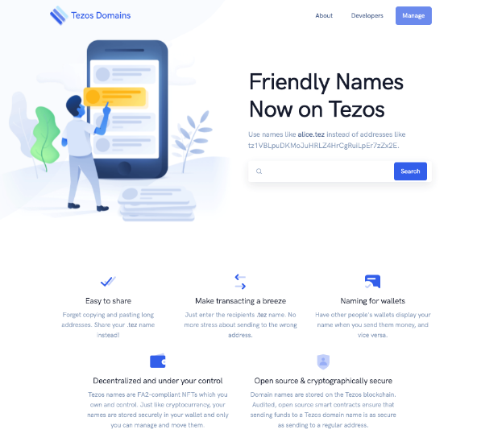
NFTs on Tezos: Tezos Domains
Tezos Domains is a platform that leverages FA2-based NFTs to register meaningful and user-friendly aliases to a Tezos address in a globally consistent way.
Tezos Domains was launched in April 2021 after a sunrise period where bakers and Tezos-related open-source projects had the opportunity to claim their Tezos Domain.
After the launch, all domains with 5+ characters were eligible for purchase via auctions and have been available for first-in-first-served (FIFS) registration since May 12th, 2021.
Names with less than five characters are available since Q3 2021.
Among the design principles were price and distribution fairness, disincentivation of name squatting/speculation, usability (easy to read, pronounce, communicate), security (e.g. spoofing).
The top-level-domain (TLD) controlled by a multisig contract planned to eventually migrate to a DAO is .tez.
The second-level-domains are subject to auctioning/FIFS registration.
Third-and-higher-level-domains can be created and managed at the user’s leisure (i.e. the owner of the second-level domain).
Tezos domains are censorship resistant as they do not rely on third parties like Google Domains or Go Daddy.
Tezos Domains supports all major wallets via Beacon integration and names are displayed in wallets instead of cryptic addresses.

Slide 66

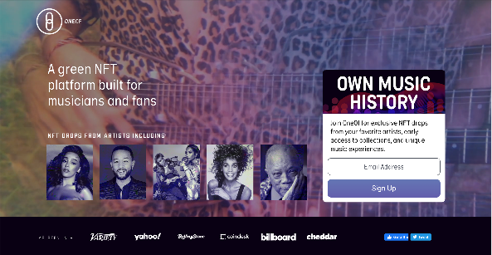
NFTs on Tezos: OneOf
OneOf is a Tezos-based commercial platform for music NFTs announced to launch in summer 2021 and has recently raised $63M of funding from a seed round.
It is – among others - backed by Quincy Jones and has already secured 212 big-name NFT drops for the first 12 months, the estate of Whitney Houston, TLC, Doja Cat, John Legend prominent among them.
While the NFTs will be Tezos-based, OneOf will accept payments both in (other) crypto and 135+ fiat currencies to make the platform accessible to a wide audience.
Tezos’ eco-friendliness due to its low energy consumption and its comparatively low transaction costs were not only the basis for OneOf’s decision to build on Tezos, but also serve as the basis for convincing artists to mint their NFTs on OneOf.
OneOf announced to donate 5% of revenue from every sale to a charity of the artist’s choice or an environmental cause partner and commited to zero minting costs (while there will be a commission on every transaction made on the marketplace).
OneOf will provide onboarding support for artists willing to bring their NFT vision to life and plans on supporting influential new voices through financial commitments and marketing support with their Emerging Artist Spotlight Program.
To empower artists of every career level, there will be different tiers from “one-of-one tokens” to ”one-of-one-hundred-thousand tokens”.

Slide 67
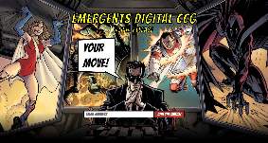
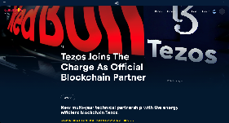
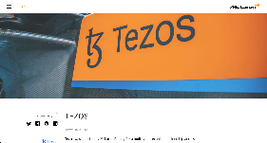
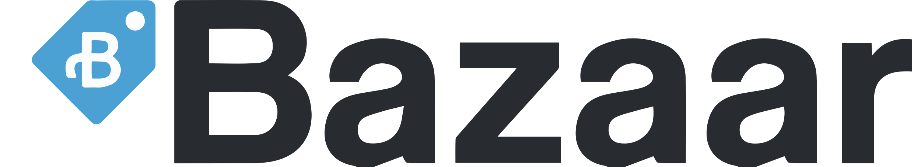
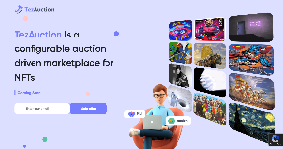
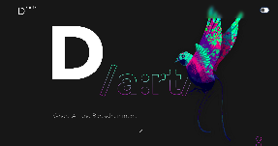


NFTs on Tezos: There‘s more – NFT Applications and Marketplaces in the Making
Emergents
Digital Collectible Card Came
RedBull Racing
NFT Fan Experience
McLaren Racing
NFT Fan Experience
The NFT space on Tezos is evolving rapidly and there are more NFT applications and marketplaces already existing or in the making. Here are just some of them…
TezAuction
Multi auction type NFT marketplace
D-art
Digital Art NFT Marketplace
Bazaar
amplify^{NFT}
Truesy
…

Slide 68
SELF-SOVEREIGN IDENTITIES
ON TEZOS

Slide 69







SSIs on Tezos: What are Self-Sovereign Identities?
Trusted digital identities are a crucial foundation for many services in today’s digital world, including (but not limited to) blockchain applications.
They are required to
  identify people, things (e.g. IoT devices), private and public/governmental organizations, etc. (“Who are they?”).
  authenticate these identities (“Are they who they claim to be?”).
  verify claims about attributes associated with their identities (“Is it true what they claim about themselves?”).
  authorize access for these identities, e.g. to restricted services, data, etc. based on their identity and/or attributes associated with their identity (“Should they be allowed in?”).
Digital identities have evolved from centralized and user-based to federated solutions where users can use their credentials from well-established identity providers to log in to third-party services.
However, federated identity solutions give an insane amount of data and power to the identity provider (e.g. which other services does user x use or which services can use the providers identity service?).
The new paradigm of self-sovereign identities (SSIs) aims to give control over their identity and data back to the users.
Although the concept itself is technology-agnostic, blockchains can be used as an important building block for SSI solutions due to their decentralized nature and their immutability.
Identification
Authentication
Authorization
I am XYZ!
I have authenticated your identity; you are who you claim to be!
Based on your authenticated identity, your verified age, and our policy, you are allowed to consume service ABC!
Claim Presentation
Claim Verification
I am an adult, here’s my credential!
I have verified your credential; you are of age!
User-Based Identity
Federated Identity
Self-Sovereign Identity
Service
X
Service
Y
Service
Z
Service
X
Service
Y
Service
Z
Service
X
Service
Y
Service
Z
=
Identity Provider
User has one account per platform/service.
Partial control of personal data but inconvenient (e.g. redundant entry of data).
User uses one account for multiple platforms/ services.
Convenient but identity provider gains power and gathers data.
User controls his own identity and presents (reusable) credentials as needed.
Convenient and private.

Slide 70

SSIs on Tezos: Concepts and Standards around SSIs
There are two emerging W3C standards that are shaping the way SSIs are being implemented: Decentralized Identifiers (DIDs) and Verifiable Credentials (VCs).
DIDs enable verifiable, decentralized digital identities. They refer to subjects (persons, organizations, things, etc.) as determined by the DID’s controller and have been designed to be decoupled from centralized registries, identity providers, and certificate authorities.
While third parties might be used to help enable the discovery of information related to a DID, the DIDs controller can prove his control independently.
DIDs are URIs that associate a DID subject with a DID document that can be used to prove control over the DID or interact with the DID subject in a trusted way. They consist of three parts: 1) The URI scheme identifier, 2) the identifier for the DID method (tz for Tezos) and the DID method-specific identifier (a Tezos address for Tezos).
VCs are a mechanism to digitally express (machine-)verifiable assertions about a (DID) subject in a cryptographically secure and privacy respecting way.
An issuer (e.g. a government) can assert or revoke a claim about a subject (e.g. “is a citizen of country XYZ”) using VCs.
Its holder (who may be the subject but could also be a guardian, like a parent) can produce a verifiable presentation from his VCs that a verifier can verify using the presentation and a verifiable data registry, e.g. a distributed ledger like the Tezos blockchain.
Tezos Namespace (= tz1, tz2, tz3, and KT1 account)
Scheme
DID Method-Specific Identifier
did:tz:tz1aaYoabvj2DQtpHz74Z83fSNjY29asdBfZ
DID Method
tz for Tezos DID Method according to
Tezos DID Method Specification and TZIP-019
Issue Credentials
Send Presentation
Issuer
Issues
Holder
Acquires, Stores, Presents
Verifier
Requests, Verifies
Verify Identifiers
and Use Schemas
Register Identifiers
and Use Schemas
Verify Identifiers
and Use Schemas
Verifiable Data Registry
Maintain Identifiers and Schemas

Slide 71
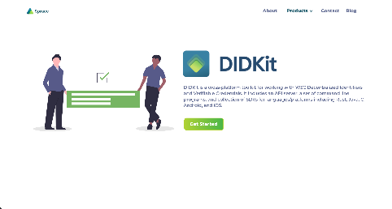
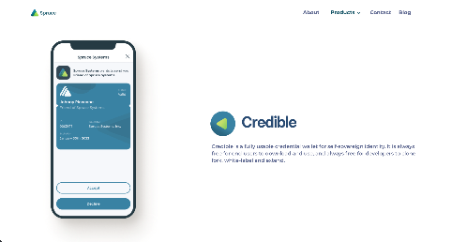
SSIs on Tezos: Spruce Systems
Spruce Systems is a company that envisions to “go from untrusted data to verifiable information that can be shared privately and with consent“ and that is committed to open source software (usually published under Apache License, Version 2.0).
Spruce is a member of W3C and actively contributing to the development of the DID and VC standards.
Based upon these standards, Spruce is building a suite of tools and Tezos-specific specifications to bring SSIs to the Tezos ecosystem:
  The Tezos DID Method that maps DIDs directly to the Tezos name space (tz1, tz2, tz3, and KT1 account addresses prefixed with did:tz).
  The DIDKit for working with W3C DIDs and VCs across different platforms.
  The wallet Credible and its Kukai integration to store credentials.
  The data takeout Rebase allowing users to download their information and prove their verified activity history, reputation, and account data
While being visionary, Spruce is also pragmatic and believes in integrating with existing identity solutions rather ran replacing everything at once. Hence, they are also building:
  Keylink to link existing enterprise accounts to keypairs.
  The smart onboarding tool for businesses, Intake, for secure document collection and processing.
Notes:
“…go from untrusteddata to verifiable information that can be shared privately and with consent.”
“…creating first-class support to link with existing identity and data appliances commonly found in enterprise environments, including identity servers, internal resource APIs, key management systems, ERPs, and cloud services.”
“…tools for the issuance, storage, verification, and governance of trusted information to allow any Tezos account to demonstrate who (or what) they are on their own terms, without sacrificing privacy.”
“To drive impact outside of on-chain transactions and smart contracts, blockchains must construct read and write pointers to the real-world as secure digital representations. Anything from asset issuance, to business contract verification, to trusted oracles require some form of digital identity, which is the way we recognize, remember, and respond to other actors.”
“Our long-term vision is to enable every Tezos wallet with identity capabilities and to allow any project to issue credentials for end-users to utilize throughout their various journeys. ”
“…we are developing a library to provide functionality around Verifiable Credentials (VC) in Rust. We chose Rust for its speed, predictable performance, and safety.”
“The optional nine-digit social security number (SSN) is at the core of every American’s administrative identity — and it is also a major attack vector for most kinds of financial fraud. […] But it is as valuable to falsify identification as it is to verify it: it is a valuable target for malicious actors due to the plausibility and control it grants upon presentation when impersonating its proper subject.”
“We propose the addition of an opt-in authenticator to separate concerns, gradually shifting the SSN to serve as an identifier only and to double no longer as an authenticator.”
“Due to its opt-in nature, this simply grants choice to users and systems that value security, and does not force any other workflows to be affected.”
“Historically, reliance on national ID systems has enabled governments to discriminate against and deny the rights of individuals to purchase property, open a bank account, or receive government benefits. They also create massive liabilities for governments through data breaches.”
“Our products handle statements about an ecosystem’s actors and assets, including certificates, licenses, audit reports, and formal approvals, packaging them digitally so that they are tamper-proof, information minimizing, and traceable within a data supply chain.”
“Consider a rideshare driver selling services within a decentralized marketplace who presents a valid license and driving history digitally-signed by the local DMV, proof of insurance from Geico, and a clean background check issued by Checkr (the same company used by Uber), all privately and securely without an intermediary. With this model, we are that much closer to a reality in which the trust portion of transaction costs within a decentralized market are no longer prohibitive, and the platform’s take of the revenue moves from 25% to $0.25. The surplus goes to the consumers and actual service providers.”
“Design and development are now underway for our native credential wallet called Credible. We see Credible as the Amazon Basics of credential wallets for the consumption, storage, and presentation of verifiable credentials on Android and iOS. It will be free to download and use, and it will support the core credential formats and protocols.”
“DIDKit is a cross-platform toolkit for working with W3C Decentralized Identifiers (DIDs) and Verifiable Credentials (VCs). It allows you to resolve and manage DID documents, and also manage the entire lifecycle of Verifiable Credentials including their issuance, presentation, and verification.”
“Intake is a smarter onboarding tool for businesses via secure document collection and processing. These artifacts can then be used as evidence to generate and issue credentials to the counterparty that originally uploaded them.”
“Ambitious end-to-end DID/VC systems like the “agent frameworks” of the Hyperledger Aries project invite developers to build out a whole new kind of cloud architecture rather than integrating to today’s clouds, browsers, and enterprise ecosystems. This has channeled the energies of countless early adopters and experimenters and created a fascinating ecosystem, but it does not provide developers new to the space with architecturally un-opinionated, readily pluggable libraries.”
“Verifiable Credentials (VCs) are a cryptographically-signed, contextualized, and highly portable data format used to represent beliefs about reality, such as someone’s educational certifications, employment history, and licenses. They can also be used to represent beliefs about non-person entities (NPEs) such as code repositories, IoT devices, and data sets.”
“Decentralized Identifiers (DIDs) are a kind of URI that can be universally resolvable across the Internet, public blockchains, and other data sources. They are used in conjunction with a DID method to establish public key-based control authority of a “DID controller” and enable service discovery of “service endpoints.” People may manage several DIDs each to keep different aspects of their life separate and private. DIDs may also be managed by non-person entities, such as software agents, industrial equipment, and computer servers.”
“VCs and DIDs may be used together in powerful patterns, built from the fundamental issuance, storage, verification, and revocation workflow. DIDs can be used to cryptographically sign VCs, and because most DIDs can be resolved to their public keys, anyone can then verify the produced VC as authentic and tamper-proof, thereby increasing their trust of the information inside.”
“Spruce takes the position that when it comes to user data, only the absolute minimum amount necessary should be stored on public blockchains.”

Slide 72
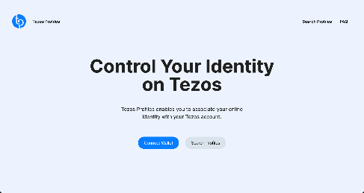
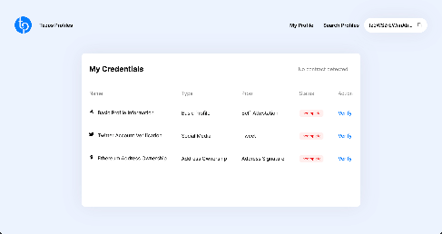
SSIs on Tezos: Tezos Profiles
Tezos Profiles (TZP) was built by Spruce Systems based on their previously introduced tools.
It is a web application that aims at empowering Tezos users to regain control of their digital identity for use across platforms by allowing users to create portable verified profiles.
Verification is done by demonstrating control over their public social media and by self-attesting information. These verified profiles are then linked to Tezos accounts, allowing any platform to resolve and establish trusted information to mitigate identity fraud:
  A user connects a Temple/Spire/Galleon/Kukai wallet via Beacon integration and chooses a Tezos address within that wallet.
  The user fills in a basic profile with information about himself (an alias, a description, a website URL and a URL to a logo image)
  The user verifies his identity by posting a predefined Tweet on Twitter and providing the link to that Tweet, thereby demonstrating control over the given Twitter account.
A first use case has arisen with the accelerated growth of NFT adoption, creator impersonation and copyminting: many buyers have become unsure, if an NFT is being sold by its true creator.
TZP allows creators to attest to their own “reusable” identity and credentials instead of recreating their identity across platforms in a fragmented way.
Establishing trust in this way can of course be applied to other areas.
Notes:
“The problem of establishing trust between parties is not unique to artists. In the payments and financial services industries, this is often required. The same technology powering creators’ TZP can also enable Tezos addresses to satisfy enterprise use cases. We intend to support verifications for corporate and enterprise stakeholders, such as proof of DNS record control, external audit reports, and corporate filings containing identity proofs.”

Slide 73

An exemplary industrial application on Tezos:
THE ENVITED ECOSYSTEM

Slide 74

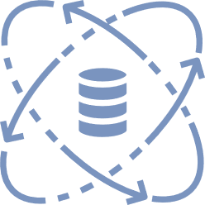













ENVITED FRAMEWORK
DATA
ECOSYSTEM
Improved interoperability in a distributed
ecosystem with not compromised data
traceability for continuous proof of validation
INNOVATION
HUB
ENVITED MEMBERS
DATA
MARKET
Joint research and development
of innovative simulation
methods and processes
ASCS OPERATOR
Cooperative database of shared,
reusable and refined simulation data
(open source, standardized, certificated, …)
from multiple sources / partners
CAREER
CHANNEL
Application-oriented strengthening
and networking of young talents
and experts
2021-11-22
Tezos Deep Dive Deck
74

Slide 75





ECOSYSTEM
traceability of certificated test data along the
supply chain
support of virtual proof
for homologation (ISO26262)
enables global markets by
reducing imbalance of
R&D partners
(OEMs <-> Start-ups)
2021-11-22
Tezos Deep Dive Deck
75

Slide 76




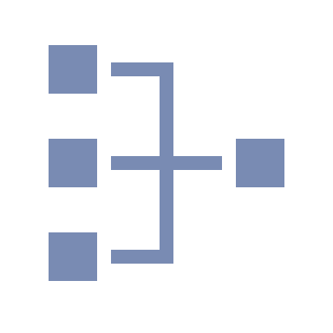
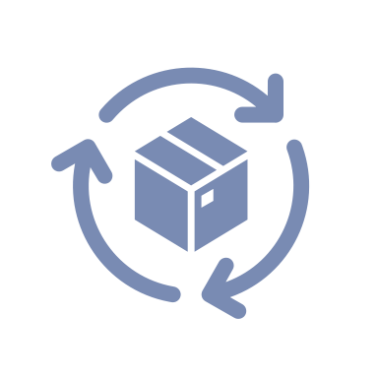

THE ENVITED ECOSYSTEM: What is ENVITED‘s Goal?
With the ultimate goal of enabling virtual proof for homologation (the governmental approval process for vehicles), the ENVITED working group has set out to create an ecosystem in which:
  Trusted data marketplaces provide (fair) access to relevant source data (like map data, city models, material data, driving scenarios, etc.) and traceability of their provenance.
  Test/simulation results and certifications can be documented in a traceable and provable yet privacy preserving (i.e. protecting business secrets and intellectual property) way.
  Authorities can access and validate the data (incl. tracing the entire data supply chain) and formally grant their approval in a legally binding way.
To achieve this ambitious goal, a powerful cross-company consortium consisting of automotive OEMs, (data) suppliers, simulation and PLM software vendors, and academic partners has assembled under the ENVITED umbrella and its patron asc(s e.V.
While there is still a long way to go and many (research) questions to be resolved, ENVITED has already produced some promising results.
Parties interested to join the community and contribute to our common goal should contact the asc(s e.V. office.
WHY DO WE NEED VIRTUAL PROOF FOR HOMOLOGATION?
The growing proportion of software in modern cars leads to increased update frequencies as well as growing dependencies and overall complexity.
Simultaneously, product lifecycles get shorter or even “blur” and requirements for quality, certification and approval get ever stricter.
The consequence: conventional methods of validation (physical testing) do not suffice to handle the amount of required testing anymore and need to be complemented with trusted virtual counterparts.
increased update
frequencies
growing proportion
of software
growing
dependencies
shortening product
life cycles
stricter
requirements
2021-11-22
Tezos Deep Dive Deck
76

Slide 77
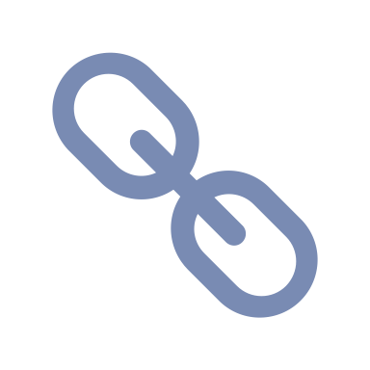



THE ENVITED ECOSYSTEM: Why Blockchain?
When analyzing the ecosystem in which our envisioned solution is going to operate and the requirements imposed by the regulatory authorities (as well as our own aspirations), (public) blockchain technology appears to be a perfect fit:
  Diverse multi-agent ecosystem with (partly) diverging interests and a need for cooperation in a competitive environment (e.g. automotive OEMs are competitors, yet all require the same map data that would be prohibitively expensive to generate for only one player).
  Strong need for (public) immutable documentation, transparency and complete traceability of the entire data supply chain, incl. data provenance, data ownership, data validation and certification.
  Strong need for efficiency through automation of business processes, interactions, and execution of (smart) contract conditions.
While firmly believing in the power of blockchain technology, we also acknowledge its (current and future) limitations with respect to storage of large amounts of data, conflicts with protection of personal data (cf. GDPR) as well as business secrets.
We believe in blockchain as an important building block in the architecture of our solution that provides data trust and integrity.
WHY WE BELIEVE IN PUBLIC BLOCKCHAIN TECHNOLOGY
Provide trust in a trustless environment
Immutable documentation
Transparency
Automated contract execution
HOW WE EMPLOY PUBLIC BLOCKCHAIN TECHNOLOGY
Hybrid System:
Blockchain as settlement layer
for value transactions and trust
Separate cloud system
for storage of actual data
2021-11-22
Tezos Deep Dive Deck
77

Slide 78






THE ENVITED ECOSYSTEM: Why Tezos?
As this slide deck should have conveyed already, we believe that Tezos is a superior and future-proof public blockchain.
Among the reasons for building on Tezos, we consider (non-exhaustive list):
  Tezos’ low energy LPoS mechanism and efficient consensus algorithm Emmy* that enable fast transactions in an environmentally friendly way.
  The stability and future safety achieved through on-chain governance that enables upgrades while avoiding forks.
  Formally verifiable smart contracts and the certified compiler from higher level programming languages that enable automated contract execution while not having to blindly trust that a smart contract does what its developer claims or thinks it does.
  Enablement of privacy-preserving transactions through Sapling.
  Emergence of convenient and future proof identity and access management and (revokable) certifications by SSI tooling developed by Spruce Systems.
  Potential usage of FA2-based NFTs (open research question).
  Tezos’ strong and vibrant open-source community that is committed to helping each other out.
WHY WE CHOSE TEZOS AS THE BLOCKCHAIN FOR ENVITED
Low energy consumption
Fast transactions
On-chain governance
Formally verifiable smart contracts
Privacy-preserving transactions
SSI
NFTs
Strong community
2021-11-22
Tezos Deep Dive Deck
78

Slide 79



THE ENVITED ECOSYSTEM: ENVITED as Blueprint for other Projects on Tezos
While we have encountered our fair share of challenges, we believe that we have done a good job so far and our organizational set-up as well as the (high-level) architecture of our solution can be used as a template for other initiatives (even from entirely different industries) of how to build industrial grade applications based on Tezos.
  ENVITED is exemplary when it comes to reconciling industrial players with an open-source community.
  As an “e.V.” (a German legal structure for an association that serves a common cause of its members), ENVITED works as an interface for the automotive industry to engage with the community and to align on requirements as well as industry standards (e.g. industry-specific smart contract templates).
  The “e.V.” allows to add an additional governance layer to complement the on-chain governance with an off-chain and industry-/application-specific governance that provides a context in which the industry standards and solutions can be deployed (it is basically the pendant of an on-chain DAO).
  Employing the Tezos blockchain as an (admittedly very important) building block of a larger solutions.
We are happy to share our experiences and give you a leg up, if you want to build an industrial application on Tezos.
WHY ENVITED COULD SERVE AS A BLUEPRINT FOR OTHERS
Industrial
players
“Interface”
Open-source
community
complements
Industry-specific
off-chain governance
On-chain
governance
2021-11-22
Tezos Deep Dive Deck
79

Slide 80
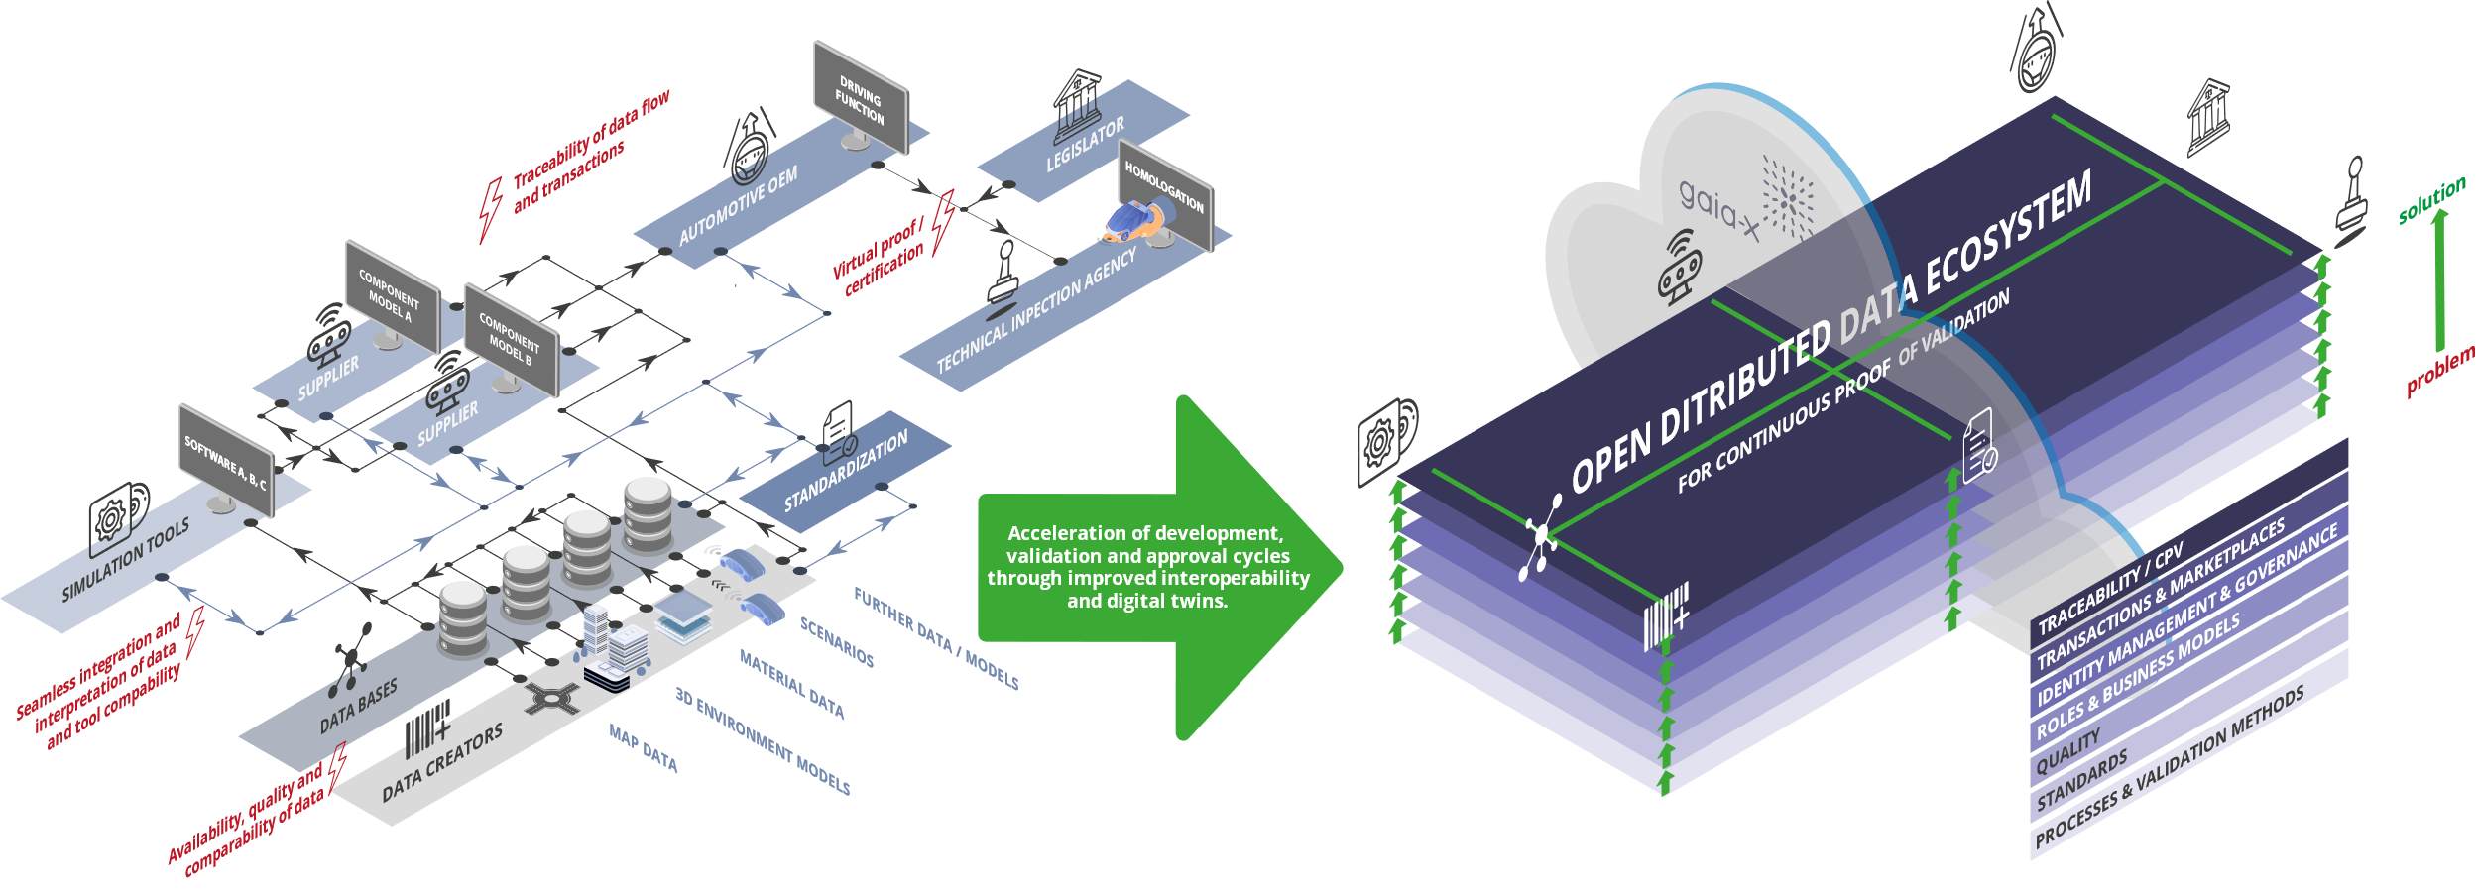
DATA DRIVEN DEVELOPMENT PROCESS
Current status
Target ENVITED ecosystem
2021-11-22
Tezos Deep Dive Deck
80

Slide 81
ECOSYSTEM CHALLENGES
Immutable Documentation for worldwide authority- and customer- acceptance.
Transparency of the process solving Digital Rights Management.
Automated Contract Execution to reduce manual overhead.
Licensing for safe usage and oriented towards the purpose.
Certification of models and data for seamless integration.
Convenient Access Management for diverse partners (in an unequal power structure for naturally opposing parties across borders worldwide).
Most of the ecosystem’s challenges can be addressed by the Tezos blockchain and/or solutions evolving around Tezos!
2021-11-22
Tezos Deep Dive Deck
81

Slide 82




ECOSYSTEM, VALIDATION ENHANCED
Audit!
Verify
Homologation
Continuous Virtual Proof of Validation
software landscape
OpenPROOF
ENVITED ecosystem
Open Public Standard
Tools & Services
public open blockchain
2021-11-22
Tezos Deep Dive Deck
82

Slide 83


MYTHBUSTERS
Notes:
This is one of the core pitch slides: It opens the last chapter of the storyline „Why blockchain? Why public blockchain? Why Tezos?“

Slide 84
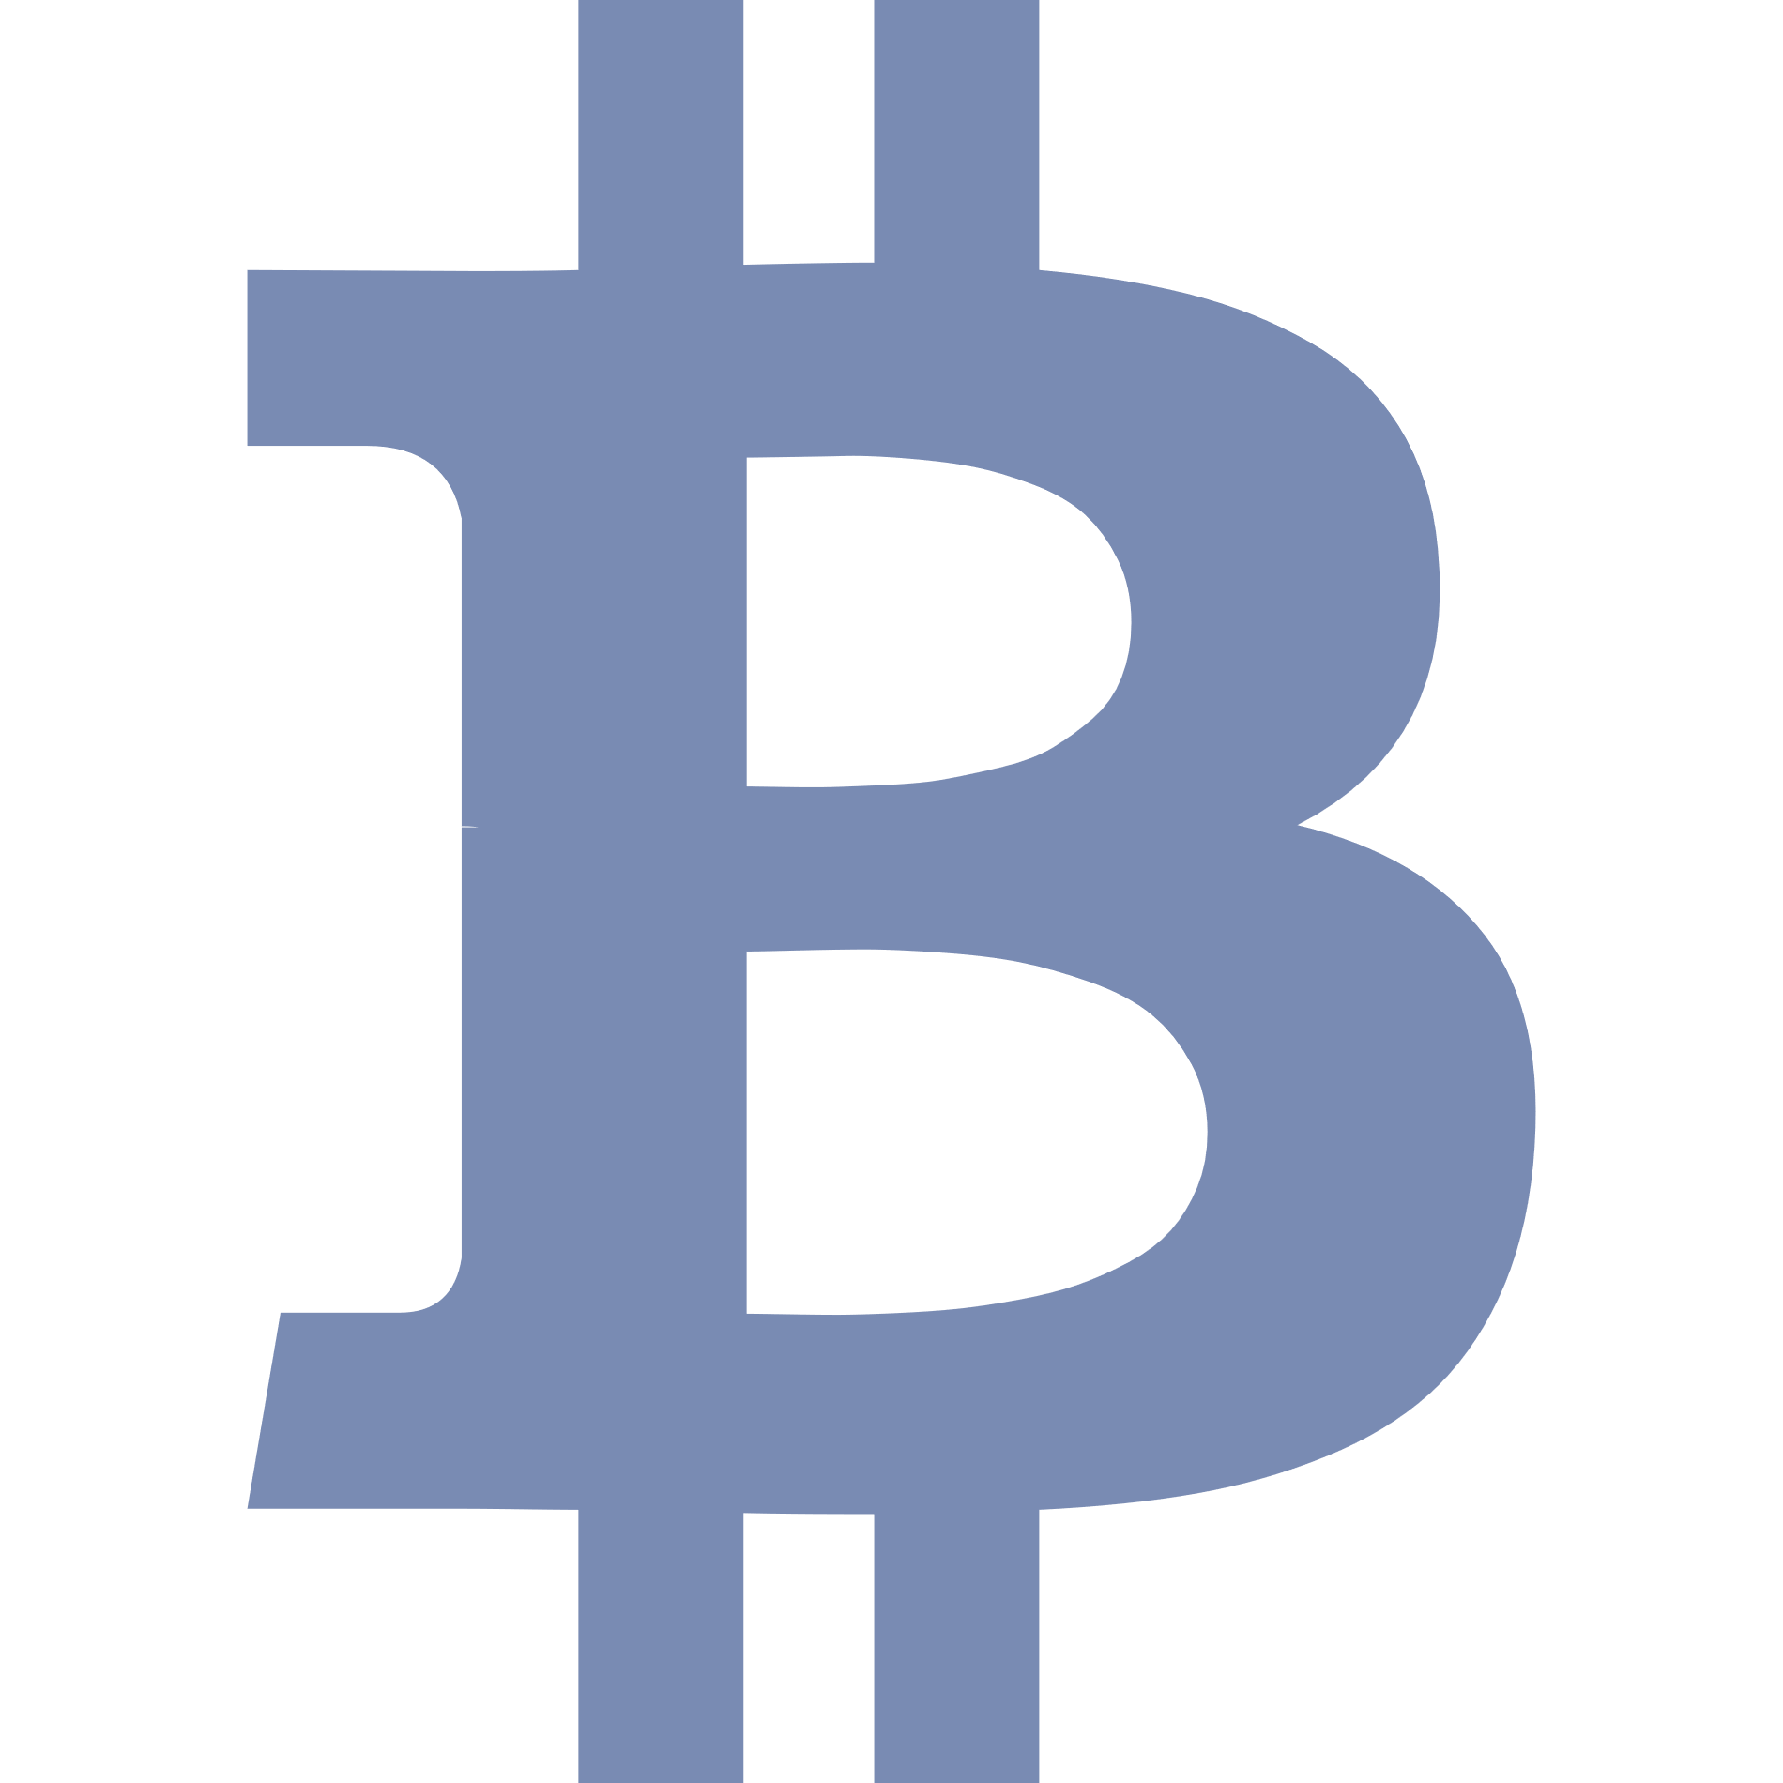

Mythbusters - #1 Bitcoin and blockchain are NO SYNONYMS
Bitcoin ≠ Blockchain
As Bitcoin was the first blockchain in the world, Bitcoin and blockchain are often confused with one another. However, they are not the same! Blockchain is a technological concept and an umbrella term for any technology following that concept. The relationship between Bitcoin and blockchain is thus better characterized as: Bitcoin $⊆$ Blockchain!
Notes:
The mythbuster slides are well suited for presentations and target less informed audiences.

Slide 85
Mythbusters - #2 Blockchains consume a tremendous amount of energy
Blockchain ≠ Tremendous Energy Consumption
Bitcoin uses a Proof-of-Work mechanism to prevent Sybil attacks that does consume a lot of energy. With Bitcoin still being the most prominent blockchain and media reporting comparisons of Bitcoin’s energy consumption with that of countries, the impression that blockchain requires a lot of energy stuck. However, there are other Sybil control mechanisms such as Proof-of-Stake that do not require a significant amount of energy. The Tezos protocol uses Liquid Proof-of-Stake which is low energy!
Notes:
The mythbuster slides are well suited for presentations and target less informed audiences.

Slide 86
Mythbusters - #3 Liquid Proof-of-Stake is NOT a consensus algorithm
(Liquid) Proof-of-Stake ≠ Consensus Algorithm
Neither Liquid Proof-of-Stake nor any other Proof-of-Stake mechanism (nor Proof-of-Work for that matter) constitutes a consensus algorithm. The PoX family is a group of mechanisms designed to protect the network and its consensus algorithm against Sybil attacks (i.e. an attacker creating a lot of fake nodes to gain control over the network). They can thus be referred to as Sybil control mechanisms and yes – they are closely entwined with consensus algorithms, but they are not the same thing!
Notes:
The mythbuster slides are well suited for presentations and target less informed audiences.

Slide 87
Mythbusters - #4 Liquid Proof-of-Stake is NOT the same as Delegated Proof-of-Stake
Liquid Proof-of-Stake ≠ Delegated Proof-of-Stake
As delegation is an integral part of Liquid Proof-of-Stake (LPoS), it is often confused with Delegated Proof-of-Stake (dPoS) as known from EOS and Lisk. However, they are different concepts, with very different grades of decentralization and – respectively – network security. While the number of validators is limited to 21 in EOS and 101 in Lisk and more static, in Tezos’ LPoS it is only bounded by the maximum number of rolls depending on the total supply of tez and more dynamic.
Notes:
The mythbuster slides are well suited for presentations and target less informed audiences.

Slide 88
Mythbusters - #5 Smart Contracts are NEITHER “smart” NOR legally binding contracts
Smart Contracts = ¬Smart $∧$ ¬Legal Contracts
Smart contracts are neither legally binding nor are they smart on their own accord. Smart contracts are relatively simple computer programs that are deployed on the blockchain, allow the automated execution of (inter-party) processes and thus the automated execution of contract conditions.
Notes:
The mythbuster slides are well suited for presentations and target less informed audiences.

Slide 89
Mythbusters - #6 The existence of the cryptocurrency does NOT require you to use it in your app
You Don’t Need to Use the Token in Your App
Public blockchains require a cryptocurrency to provide economic incentives for its validators to maintain the network. But just because a blockchain has a token, it does not require you to actively use that token in the application you build on top of the blockchain. You will have to pay for using it by the means of the cryptocurrency but it does not have to play a role in your use case!
Notes:
The mythbuster slides are well suited for presentations and target less informed audiences.

Slide 90
Mythbusters - #7 Blockchain is NOT just a technology searching for its problem
Blockchain has real world applications
As blockchain is a very young yet non-trivial technology, there are a lot of failed or stuck blockchain projects and blockchain has been accused of just being a technology searching for its problem. However, blockchain does have its real world applications it’s rather a matter of understanding the technology, its strengths and weaknesses and selecting those applications it is actually well-suited for!
Notes:
The mythbuster slides are well suited for presentations and target less informed audiences.

Slide 91


NOTE ON PUBLICATION
The Tezos Deep Dive Deck 2.0 is licensed under the Creative Commens CC BY 4.0.
This document was created within the activities of the ENVITED research cluster and serves as training and further education material in the ENVITED Career Channel and the ENVITED academy.
2021-11-22
Tezos Deep Dive Deck
91

Slide 92



Get in touch with us!
Dipl.-Ing. Alexander F. Walser
Managing Director
Automotive Solution Center for Simulation e.V.
Curiestraße 2 | 70563 Stuttgart | Germany
Phone: +49 (0) 711 699659-0 | Fax: +49 (0) 711 699659-29
Email: hello@envited.market
Web: www.asc-s.de | www.envited.market
Tezos Deep Dive Deck - Licensed under CC BY 4.0

Slide 93
REFERENCES
NOTE:
WE HAVE ONLY BEGUN TO LIST REFERENCES TO SOURCES CONSULTED TO COMPILE THIS SLIDE DECK WITH THE SEPTEMBER 2021 UPDATE.
WHILE WE ARE COMMITTED TO MAKE THESE SOURCES TRANSPARENT AND INFORMATION CONTAINED IN THIS SLIDE DECK VERIFYABLE, REFERENCES TO SLIDES FROM THE INITIAL RELEASE OF THE DECK ARE STILL MISSING.

Slide 94
References for Slide:
Why public blockchains are the future…
[1]
https://www.marigold.dev/project/optimistic-rollups (A layer 2 solutions for scalability)
[2]
https://blog.nomadic-labs.com/a-look-ahead-to-tenderbake.html (New consensus algorithm with deterministic finality)
[3]
https://research-development.nomadic-labs.com/sapling-integration-in-tezos-tech-preview.html (Selective privacy integration with Sapling)

Slide 95
References for Slide:
Why public blockchains are the future: Developments in scaling and privacy technologies
[1]
https://medium.com/boltlabs/introducing-zkchannels-on-tezos-c365830b9efd (zkChannels eliminates lag time and high transaction fees - while offering strong privacy protections — so you can use Zcash, Bitcoin, Tezos and other digital currencies for everyday payments and purchases)
[2]
https://news.tezoscommons.org/a-closer-look-into-marigolds-plans-for-tezos-b682b759ffa2 (a closer look into Marigold’s Layer 2 solutions)

Slide 96
References for Slide:
Some KPIs: Tezos in numbers…
[1]
https://tzstats.com/ (ꜩ Stats – information on the creation of the first block, the current block height, number of funded accounts, market capitalization, number of active validators )
[2]
https://www.tezos.help/#projects (tezos.help – information on Tezos-based projects)
[3]
https://www.tezosagora.org/period/50 (Tezos Agora - information on number of successful amendments/protocol updates [replace ”50” with respective period to inspect or browse by clicking the linked arrows])
[4]
https://wiki.tezosagora.org/learn/baking/proofofstake/consensus#scalability (Tezos Agora Wiki – information on transactions per second)
[5]
https://www.tezosprojects.com/ (A non-exhaustive list of projects using Tezos)

Slide 97
References for Slide:
Some KPIs: Growth in Smart Contract Calls
[1]
https://better-call.dev/stats/mainnet/general (Better Call Dev – Tezos Smart Contract Explorer by Baking Bad )

Slide 98
References for Slide:
How the Tezos on-chain governance/amendment process works
[1]
https://wiki.tezosagora.org/learn/governance (Tezos Agora Wiki - Tezos Governance)
[2]
https://medium.com/tezos/amending-tezos-b77949d97e1e (Medium - Jacob Arluck on the version of the amendment process valid in 2018)
[3]
https://www.tezosagora.org/period/12 (Tezos Agora - proposal description for Athens: reduction in roll size)
[4]
https://www.tezosagora.org/period/18 (Tezos Agora - proposal description for Babylon: introduction of quorum floor and cap and 5% hurdle)
[5]
https://www.tezosagora.org/period/39 (Tezos Agora - proposal description for Edo: introduction of Adoption period and shortened periods)
[6]
https://www.tezosagora.org/period/44 (Tezos Agora - proposal description for Florence: discarding of testnet fork and rechristening of Testing period to Cooldown period)
[7]
https://forum.tezosagora.org/t/envited-why-the-tezos-amendment-process-needs-an-adoption-period-a-proposal-to-improve-the-on-chain-governance-mechanism/1845 (Tezos Agora - Proposition and discussion of Adoption period)
[8]
https://medium.com/tezos/there-is-no-need-for-hard-forks-86b68165e67d (Medium - Arthur Breitman on reduced necessity for hard forks due to on-chain governance)

Slide 99
References for Slide:
The Tezos consensus algorithm: Emmy / Emmy+ since Babylon / Emmy* if Granada succeeds
[1]
https://wiki.tezosagora.org/learn/baking/proofofstake/consensus (Tezos Agora Wiki - The Tezos Consensus Algorithm)
[2]
https://www.youtube.com/watch?v=uHViHhOlcz0&t=1010s (YouTube – Awa Sun Yin on Consensus Algorithms and PoX mechanisms
[3]
https://blog.nomadic-labs.com/faster-finality-with-emmy.html (Nomadic Labs Blog - Faster finality with Emmy*)
[4]
https://gitlab.com/tezos/tzip/-/blob/master/drafts/current/draft_emmy-star.md (TZIP Gitlab - Emmy* specification)

Slide 100
References for Slide:
Is there a development roadmap for Tezos?
[1]
https://blog.nomadic-labs.com/introducing-mi-cho-coq-v10.html (Nomadic Labs Blog - Introducing Mi-Cho-Coq v1.0)
[2]
https://blog.nomadic-labs.com/simulating-tenderbake.html (Nomadic Labs Blog - Simulating Tenderbake)
[3]
https://blog.nomadic-labs.com/announcing-the-report-possible-evolutions-of-the-voting-system-in-tezos.html (Nomadic Labs Bl)og - Announcing the report “Possible evolutions of the voting system in Tezos
[4]
https://gitlab.com/tezos/tzip/-/merge_requests/133 (TZIP - Draft: baking accounts proposal)
[5]
https://gitlab.com/tezos/tzip/-/blob/5adee1ca26925d2e65e363b900689da090557497/drafts/current/draft-baking_accounts.md (TZIP - Baking Accounts)

Slide 101
References for Slides:
The self-amendment process works: 6 successful amendments and counting… (1/2) & (2/2)
[1]
https://www.tezosagora.org/period/12 (Tezos Agora - proposal description for Athens)
[2]
https://www.tezosagora.org/period/18 (Tezos Agora - proposal description for Babylon)
[3]
https://www.tezosagora.org/period/24 (Tezos Agora - proposal description for Carthage)
[4]
https://www.tezosagora.org/period/35 (Tezos Agora - proposal description for Delphi)
[5]
https://www.tezosagora.org/period/39 (Tezos Agora - proposal description for Edo)
[6]
https://www.tezosagora.org/period/44 (Tezos Agora - proposal description for Florence)

Slide 102
References for Slides:
An overview of Tezos‘ self-amendment history so far… (1/2) & (2/2)
[1]
https://www.tezosagora.org/period/50 (Tezos Agora - replace ”50” with respective period to inspect or browse by clicking the linked arrows)

Slide 103
References for Slides:
Delphi – the fourth amendment to the Tezos protocol
[1]
https://www.tezosagora.org/period/35 (Tezos Agora - proposal description for Delphi)
[2]
https://blog.nomadic-labs.com/delphi-official-release.html (Nomadic Labs Blog – Delphi: official release notes)
[3]
https://blog.nomadic-labs.com/delphi-changelog.html (Nomadic Labs Blog – Delphi: changelog)
[4]
https://nomadic-labs.com/ (Nomadic Labs Website)
[5]
https://metastate.dev/ (Metastate Website [retired website] )
[6]
https://twitter.com/AlfourG (Twitter Profile of Gabriel Alfour)

Slide 104
References for Slide:
Edo – the fifth amendment to the Tezos protocol
[1]
https://www.tezosagora.org/period/39 (Tezos Agora - proposal description for Edo)
[2]
https://tezos.gitlab.io/protocols/008_edo.html (Tezos Gitlab – Edo: official release notes & changelog)
[3]
https://medium.com/@MetastateTeam/governance-improvements-725fba622615 (Medium – Metastate on Governance Improvements)
[4]
https://blog.nomadic-labs.com/sapling-integration-in-tezos-tech-preview.html (Nomadic Labs Blog - Tech Preview on Sapling integration in Tezos )
[5]
https://tezos.gitlab.io/active/sapling.html (Tezos Gitlab – Sapling integration)
[6]
http://zerocoin.org/media/pdf/ZerocoinOakland.pdf (Further reading on Sapling’s origin (paper) – Zerocoin: Anonymous Distributed E-Cash from Bitcoin)
[7]
https://github.com/zcash/zips/blob/master/protocol/sapling.pdf (Further reading - Zcash Protocol Specification)
[8]
https://tezos.gitlab.io/active/michelson.html#michelsontickets (Tezos Gitlab – Operations on tickets)
[9]
https://medium.com/tezos-israel/tickets-on-edo-simply-explained-c5a411cc27f9 (Medium – Adam Shinder explains Tickets on Edo)
[10]
https://medium.com/tqtezos/tickets-on-tezos-part-1-a7cad8cc71cd (Medium – Eli Guenzburger explains Tickets on Edo)
[11]
https://nomadic-labs.com/ (Nomadic Labs Website)
[12]
https://metastate.dev/ (Metastate Website [retired website] )

Slide 105
References for Slide:
Florence – the sixth amendment to the Tezos protocol
[1]
https://www.tezosagora.org/period/44 (Tezos Agora - proposal description for Florence)
[2]
https://blog.nomadic-labs.com/florence-our-next-protocol-upgrade-proposal.html (Nomadic Labs Blog – Florence: official release notes)
[3]
http://doc.tzalpha.net/protocols/009_florence.html (Tezos Gitlab – Florence: changelog)
[4]
https://blog.nomadic-labs.com/baking-accounts-proposal-contains-unexpected-breaking-changes.html (Nomadic Labs Blog - Reasoning for postponement of baking accounts)
[5]
https://nomadic-labs.com/ (Nomadic Labs Website)
[6]
https://tarides.com/ (Company website of Tarides)
[7]
https://twitter.com/dailambda (Twitter Profile of DaiLambda)
[8]
https://gitlab.com/keefertaylor (Gitlab Profile of Keefer Taylor)

Slide 106
References for Slide:
Granada – the seventh amendment to the Tezos protocol (?)
[1]
https://www.tezosagora.org/period/50 (Tezos Agora - proposal description for Granada)
[2]
https://blog.nomadic-labs.com/announcing-granada.html (Nomadic Labs Blog – Announcing Granada)
[3]
https://tezos.gitlab.io/protocols/010_granada.html (Tezos Gitlab – Granada: changelog)
[4]
https://blog.nomadic-labs.com/faster-finality-with-emmy.html (Nomadic Labs Blog - Faster finality with Emmy*)
[5]
https://gitlab.com/tezos/tzip/-/blob/master/drafts/current/draft-liquidity_baking.md (Gitlab - Liquidity Baking)
[6]
https://nomadic-labs.com/ (Nomadic Labs Website)
[7]
https://tarides.com/ (Company website of Tarides)
[8]
https://twitter.com/dailambda (Twitter Profile of DaiLambda)
[9]
https://tqtezos.com/ (Website of TQ Tezos)

Slide 107
References for Slides:
A brief history of Tezos and the Tezos foundation (1/2) & (2/2)
[1]
https://tezos.foundation/history (Tezos Foundation - History [Site does not exist anymore])
[2]
https://www.tezosagora.org/period/50 (Tezos Agora - replace ”50” with respective period to inspect or browse by clicking the linked arrows)
[3]
https://en.wikipedia.org/wiki/Tezos (Wikipedia – Article on Tezos)
[4]
https://www.redbull.com/int-en/redbullracing/tezos-joins-as-official-blockchain-partner (Redbull Racing - partnership press release)
[5]
https://www.mclaren.com/racing/partners/tezos/ (McLaren Racing – partnership press release)
[6]
https://cdn.uc.assets.prezly.com/c35dc0ac-7d41-436a-8389-779fc91cdc67/-/inline/no/20210420ubisoftxtezoseng.pdf (Ubisoft – corporate baker press release)
[7]
https://www.societegenerale.com/en/news/press-release/first-structured-product-public-blockchain (Société Générale – STO press release)
[8]
https://www.lefigaro.fr/societes/lugh-le-pari-crypto-de-groupe-casino-20210325 (Le Figaro - Article on Groupe Casino’s stable coin Lugh)
[9]
https://exaion.edf.fr/en/exaion/our-news/exaion-edf-group-subsidiary-becomes-a-tezos-baker (Bloomberg - Article on EDF group plans as corporate baker)
[10]
https://www.bloomberg.com/press-releases/2019-07-03/btg-pactual-and-dalma-capital-to-utilize-tezos-blockchain-for-security-token-offerings-stos (Bloomberg - Article on BTG Pactual and Dalma Capital’s plans for STOs)
[11]
https://www.bloomberg.com/news/articles/2019-02-11/on-the-menu-from-chefs-club-owner-selling-property-for-crypto (Bloomberg - Article on Elevated Returns’ plans for tokenized real-estate offerings)
[12]
https://www.artnews.com/list/art-in-america/features/gans-and-nfts-1234594335/ (Art in America - Article on Hit et Nunc & Art NFTs)

Slide 108
References for Slide (1/2):
Tezos Community Rewards
[1]
https://tezoscommons.org/rewards/ (Tezos Commons Website with links to latest reward winners and nomination form)
[2]
https://tezos.foundation/an-update-on-community-engagement/ (Article on Tezos Foundation website from 09/22/2020 announcing the CRP)
[3]
https://medium.com/tezoscommons/community-rewards-for-tezos-contributors-d6e2813a83d8 (Medium article introducing and explaining the CRP)
[4]
https://medium.com/tezoscommons/tezos-community-rewards-winners-october-2020-7d1b8f520033 (Announcement of October 2020 winners)
[5]
https://medium.com/tezoscommons/tezos-community-rewards-winners-november-2020-b228fe054ae2 (Announcement of November 2020 winners)
[6]
https://medium.com/tezoscommons/tezos-community-rewards-winners-december-2020-eb46ee7af519 (Announcement of December 2020 winners)
[7]
https://medium.com/tezoscommons/tezos-community-reward-winners-january-2021-66a1e8e22d43 (Announcement of January 2021 winners)
[8]
https://medium.com/tezoscommons/tezos-community-reward-winners-february-2021-6fc3dd75e250 (Announcement of February 2021 winners)
[9]
https://medium.com/tezoscommons/tezos-community-reward-winners-march-2021-76f51cdc333f (Announcement of March 2021 winners)

Slide 109
References for Slide (2/2):
Tezos Community Rewards
[10]
https://medium.com/tezoscommons/tezos-community-reward-winners-april-2e6c2a066048 (Announcement of April 2021 winners)
[11]
https://medium.com/tezoscommons/tezos-community-reward-winners-may-2021-a1f60900816a (Announcement of May 2021 winners)

Slide 110
References for Slide:
Of Tokens and Fungibility: What are NFTs?
[1]
https://en.wikipedia.org/wiki/Non-fungible_token (Wikipedia - article on non-fungible tokens)
[2]
https://tezos.b9lab.com/fa2 (B9 Lab / Tezos Developer Portal - FA2: A unified token contract interface)
[3]
https://assets.tqtezos.com/docs/token-contracts/fa2/2-fa2-nft-tutorial/ (TQ Tezos - Tutorials)
[4]
https://medium.com/@medipedia/the-various-types-of-crypto-tokens-26bab8f6622c (Medium article naming different token applications/token classes)
[5]
https://finematics.com/what-are-nfts-and-how-can-they-be-used-in-defi/ (Finematics – What are NFTs and how can they be used in DeFi)

Slide 111
References for Slide:
NFTs on Tezos: The FA2 token standard
[1]
https://tezos.b9lab.com/fa2 (B9 Lab / Tezos Developer Portal - FA2: A unified token contract interface)
[2]
https://assets.tqtezos.com/docs/token-contracts/fa2/2-fa2-nft-tutorial/ (TQ Tezos - Tutorials)
[3]
https://gitlab.com/tezos/tzip/-/blob/master/proposals/tzip-12/tzip-12.md (TZIP Gitlab - TZIP 12)
[4]
https://medium.com/tqtezos/introducing-fa2-a-multi-asset-interface-for-tezos-55173d505e5f (Medium - article by TQ Tezos introducing the FA2 standard on Tezos)
[5]
https://opentezos.com/defi/token-standards/ (Open Tezos – Token standards)

Slide 112
References for Slide:
NFTs on Tezos: tzcolors
[1]
https://www.tzcolors.io/ (tzcolors NFT platform)
[2]
https://xtz.news/latest-tezos-news/first-nft-auctions-on-tezos-take-off-tzcolors/ (XTZ.news – Allen Walters on tzcolors)
[3]
https://blog.tezoscommons.org/the-growing-nft-momentum-3c32a4bf8c46 (Medium - The Growing NFT Momentum by William McKenzie)
[4]
https://tzkt.io/KT1CpeSQKdkhWi4pinYcseCFKmDhs5M74BkU/operations/ (tzcolors Auction House Contract in TzKT blockchain explorer)
[5]
https://tzkt.io/KT1FyaDqiMQWg7Exo7VUiXAgZbd2kCzo3d4s/operations/ (tzcolors NFTs Contract in TzKT blockchain explorer)
[6]
https://github.com/tzcolors (Gitlab - tzcolors source code)
[7]
https://twitter.com/tzcolors (Twitter account of tzcolors)
[8]
https://www.youtube.com/watch?v=dvA4fET1ujw (YouTube – Yoeshi Roberts demonstrates and comments on bidding on tzcolors)
[9]
https://www.reddit.com/r/tezos/comments/lkfqrp/tzcolors_has_321_open_auctions_for_unique_color/ (Reddit – discussion on reception of tzcolors within the community/the users)
[10]
https://tzbutton.io/ (TzButton social experiment utilizing tzcolors)

Slide 113
References for Slide:
NFTs on Tezos: Kalamint
[1]
https://kalamint.medium.com/kalamint-bringing-nfts-to-tezos-a51daa0c38cd (Medium - Kalamint: Bringing NFTs to Tezos)
[2]
https://kalamint.medium.com/kalamint-launch-important-dates-b70613f2d4c4 (Medium - Kalamint Launch: Important Dates)
[3]
https://kalamint.medium.com/auctions-now-live-on-the-kalamint-platform-d77b142e6279 (Medium - Auctions now live on the Kalamint platform)
[4]
https://kalamint.medium.com/kalam-token-listing-on-quipuswap-on-jun-3-thu-8458d67fcca3 (Medium - $KALAM token listing on Quipuswap on Jun3, Thu.)
[5]
https://kalamint.medium.com/kalam-tokenomics-and-distribution-c1e0ccb0800b (Medium - $KALAM: Tokenomics and Distribution)
[6]
https://kalamint.medium.com/kalamint-update-4-e970fc10d914 (Medium - Kalamint Update #4)
[7]
https://kalamint.io/ (Kalamint NFT platform)

Slide 114
References for Slide:
NFTs on Tezos: hic et nunc
[1]
https://www.hicetnunc.xyz/ (hic et nunc NFT platform)
[2]
https://github.com/hicetnunc2000/hicetnunc/wiki (GitHub - hic et nunc wiki)
[3]
https://www.youtube.com/watch?v=KJSsjapuG3o (YouTube – tutorial video on NFTs on Tezos by Noealz)
[4]
https://www.youtube.com/watch?v=Apyd-I2DMVk (YouTube – tutorial video on minting NFTs on hic et nunc by Kris G)
[5]
https://gorillasun.de/blog/Hicetnunc.xyz-and-NFTs-on-the-Tezos-Blockchain-~-What's-new-~-April-2021-Update (Hicetnunc.xyz and NFTs on the Tezos Blockchain ~ What’s new ~April 2021 Mega Update)
[6]
https://www.plummerfernandez.com/works/not-another-jpeg/ (M Plummer-Fernández – Not another JPEG)

Slide 115
References for Slide (1/2):
NFTs on Tezos: Tezos Domains
[1]
https://tezos.domains/ (Tezos Domains platform)
[2]
https://blog.tezos.domains/introducing-tezos-domains-78cfadc08c75 (Medium - Introducing Tezos Domains)
[3]
https://developers.tezos.domains/design-document/smart-contract-overview (Tezos Domains Developer Documentation)
[4]
https://blog.tezos.domains/tezos-domains-for-developers-1-resolving-domains-2a037e4b9a72 (Medium - Tezos Domains for Developers #1: Resolving Domains)
[5]
https://blog.tezos.domains/tezos-domains-for-developers-2-buying-updating-domains-470497736ce1 (Medium - Tezos Domains for Developers #2: Buying & Updating Domains)
[6]
https://blog.tezoscommons.org/a-closer-look-into-tezos-domains-c1ee325752df (Medium - A Closer Look into Tezos Domains)
[7]
https://blog.tezos.domains/designing-a-tezos-name-service-part-1-introduction-4b94b2a5ac6b (Medium - Designing a Tezos Name Service – Part 1: Introduction)
[8]
https://blog.tezos.domains/designing-a-tezos-name-service-part-2-namespace-and-structure-2131bd99853b (Medium - Designing a Tezos Name Service – Part 2: Namespace and Structure)
[9]
https://blog.tezos.domains/designing-a-name-service-part-3-name-distribution-and-pricing-96429352279 (Medium - Designing a Name Service – Part 3: Name Distribution and Pricing)
[10]
https://blog.tezos.domains/designing-a-tezos-name-service-part-4-validation-normalization-encoding-73e01a5e09c9 (Medium - Designing a Tezos Name Service – Part 4: Validation, Normalization, Encoding)

Slide 116
References for Slide (2/2):
NFTs on Tezos: Tezos Domains
[11]
https://blog.tezos.domains/designing-a-name-service-part-5-retaining-trademarks-e43a89fee762 (Medium - Designing a Name Service – Part 5: Retaining Trademarks)
[12]
https://blog.tezos.domains/tezos-domains-developer-preview-550cf56b8174 (Medium - Tezos Domains Developer Preview)
[13]
https://gitlab.com/tezos-domains/contracts (Gitlab - Tezos Domains)
[14]
https://blog.tezos.domains/tezos-domains-alpha-release-1a992d15b4f8 (Medium - Tezos Domains Alpha Release)
[15]
https://twitter.com/tezosdomains?lang=de (Twitter Account of Tezos Domains)

Slide 117
References for Slide (1/2):
NFTs on Tezos: OneOf
[1]
https://oneof.com/ (OneOf landing page / future platform)
[2]
https://twitter.com/oneofnft (Twitter account of OneOf)
[3]
https://www.rollingstone.com/pro/news/oneof-nft-marketplace-quincy-jones-whitney-houston-tlc-doja-cat-crypto-1173557/ (RollongStone – Quiny Jones Is Backing a New NFT Marketplace for the Average Music Fan)
[4]
https://cointelegraph.com/news/oneof-raises-63m-for-new-green-nft-platform-for-musicians (Cointelegraph - OneOf raises $63M for new Green NFT platform for musicians)
[5]
https://www.forbes.com/sites/eamonnforde/2021/05/25/green-light-musicians-back-eco-friendlier-nfts/?sh=7373c02c573d (Forbes – Green Light: Musicians Back Eco-Friendlier NFTs)
[6]
https://www.coindesk.com/oneof-raises-63m-for-music-nft-platform-with-green-credentials (Coindesk - OneOf Raises $63M in Seed Funding to Build Music NFT Platform on Tezos)
[7]
https://www.billboard.com/articles/business/9577834/nft-marketplace-oneof-doja-cat-john-legend (billboard - Doja Cat, John Legend Join Eco-Friendly Music NFT Marketplace OneOf)
[8]
https://www.engadget.com/oneof-nft-marketplace-music-industry-140018743.html?guccounter=1 (engadget – OneOf wants to sell you a John Legend NFT)
[9]
https://labusinessjournal.com/news/2021/may/28/nft-platform-oneof-launches-63-million-funding/ (Los Angeles Business Journal – NFT Platform one of Launches With $63 Million in Funding)

Slide 118
References for Slide (2/2):
NFTs on Tezos: OneOf
[10]
https://xtz.news/nft-news/quincy-jones-john-legend-doja-cat-tld-the-estate-of-whitney-houston-tezos-oneof/ (XTZ.news – Allen Walters on OneOf)
[11]
https://oneofnft.medium.com/bringing-green-nfts-to-the-music-industry-with-tezos-902a7167f3b (Medium - Bringing Green NFTs to the Music Industry with Tezos)

Slide 119
References for Slide:
NFTs on Tezos: There‘s more – NFT Applications and Marketplaces in the Making
[1]
https://www.emergents.gg/ (Landing page of future digital collectible card game Emergents)
[2]
https://www.redbull.com/int-en/redbullracing/tezos-joins-as-official-blockchain-partner (RedBull Racing - Press release on Tezos partnership and NFT fan experience plans)
[3]
https://www.mclaren.com/racing/partners/tezos/ (McLaren Racing – Press release on Tezos partnership and NFT fan experience plans
[4]
https://tez.auction/#/ (Landing page of future multiple auction type NFT marketplace TezAuction)
[5]
https://d-art.tech/ (Landing page of future curated digital art NFT marketplace D-art)
[6]
https://bazaarnft.xyz/ (Bazaar NFT marketplace)
[7]
https://nft.amplifyx.com/xl/ (amplify^{NFT} commercial art NFT marketplace)
[8]
https://www.truesy.com/ (Truesy commercial art NFT marketplace)

Slide 120
References for Slide:
SSIs on Tezos: What are Self-Sovereign Identities?
[1]
https://www.emergents.gg/ (Landing page of future digital collectible card game Emergents)
[2]
https://www.redbull.com/int-en/redbullracing/tezos-joins-as-official-blockchain-partner (RedBull Racing - Press release on Tezos partnership and NFT fan experience plans)
[3]
https://www.mclaren.com/racing/partners/tezos/ (McLaren Racing – Press release on Tezos partnership and NFT fan experience plans
[4]
https://tez.auction/#/ (Landing page of future multiple auction type NFT marketplace TezAuction)
[5]
https://d-art.tech/ (Landing page of future curated digital art NFT marketplace D-art)
[6]
https://bazaarnft.xyz/ (Bazaar NFT marketplace)
[7]
https://nft.amplifyx.com/xl/ (amplify^{NFT} commercial art NFT marketplace)

Slide 121
References for Slide:
SSIs on Tezos: Concepts and Standards around SSIs
[1]
https://www.w3.org/TR/did-core/ (W3C – DID standard)
[2]
https://www.w3.org/TR/vc-data-model/ (W3C – VC standard)
[3]
https://did-tezos.spruceid.com/#why-a-tezos-did-method (Tezos DID Method Specification)
[4]
https://gitlab.com/tezos/tzip/-/blob/master/proposals/tzip-19/tzip-19.md (TZIP-019)
[5]
https://spruceid.dev/docs/primer/ (Spruce Systems Developer Portal – What is Decentralized Identity?)
[6]
https://identity.foundation/peer-did-method-spec/ (W3C – Peer DID Method Specification)
[7]
https://did-tezos.spruceid.com/#why-a-tezos-did-method (Tezos DID Method Specification)

Slide 122
References for Slide (1/3):
SSIs on Tezos: Spruce Systems
[1]
https://sprucesystems.medium.com/introducing-spruce-8e3116b581a6 (Spruce Systems Blog on Medium – Introducing Spruce)
[2]
https://sprucesystems.medium.com/announcing-decentralized-identity-on-tezos-4bf266a7af3f (Spruce Systems Blog on Medium – Announcing Decentralized Identity on Tezos)
[3]
https://sprucesystems.medium.com/spruce-developer-update-1-3efef055ab9d (Spruce Systems Blog on Medium – Spruce Developer Update #1)
[4]
https://sprucesystems.medium.com/reimagining-the-social-security-number-bdb17559ddb (Spruce Systems Blog on Medium – Reimagining the Social Security Number)
[5]
https://sprucesystems.medium.com/spruce-joins-the-w3c-4cae3a9357c4 (Spruce Systems Blog on Medium – Spruce Joins the W3C)
[6]
https://sprucesystems.medium.com/spruces-origins-decentralized-markets-and-identity-4fda40c6db49 (Spruce Systems Blog on Medium – Spruce‘s Origins, Decentralized Markets, and Identity)
[7]
https://sprucesystems.medium.com/spruce-developer-update-2-484368f87ee9 (Spruce Systems Blog on Medium – Spruce Developer Update #2)
[8]
https://sprucesystems.medium.com/spruce-joins-the-decentralized-identity-foundation-200bd2948ad0 (Spruce Systems Blog on Medium – Spruce Joins the Decentralized Identity Foundation)
[9]
https://sprucesystems.medium.com/spruce-developer-update-3-8565d9a1cf23 (Spruce Systems Blog on Medium – Spruce Developer Update #3)

Slide 123
References for Slide (2/3):
SSIs on Tezos: Spruce Systems
[10]
https://did-tezos-draft.spruceid.com/ (W3C – Tezos DID Method Specification)
[11]
https://sprucesystems.medium.com/introducing-didkit-an-identity-toolkit-e0dfa292f53d (Spruce Systems Blog on Medium – Introducing DIDKit)
[12]
https://sprucesystems.medium.com/spruce-developer-update-4-cd6472c58fe1 (Spruce Systems Blog on Medium – Spruce Developer Update #4)
[13]
https://sprucesystems.medium.com/spruce-developer-update-5-86d6f517a220 (Spruce Systems Blog on Medium – Spruce Developer Update #5)
[14]
https://sprucesystems.medium.com/spruce-developer-update-6-d9e692a13668 (Spruce Systems Blog on Medium – Spruce Developer Update #6)
[15]
https://sprucesystems.medium.com/credible-v0-1-is-live-6d81a50b7967 (Spruce Systems Blog on Medium – Credible v1.0 is Live)
[16]
https://sprucesystems.medium.com/decentralized-identity-with-the-tezos-did-method-d9cf6676dd64 (Spruce Systems Blog on Medium – Decentralized Identity with the Tezos DID Method)
[17]
https://sprucesystems.medium.com/spruce-developer-update-7-5fe6776f25bb (Spruce Systems Blog on Medium – Spruce Developer Update #7)
[18]
https://sprucesystems.medium.com/spruce-developer-update-8-70f04e95a5d4 (Spruce Systems Blog on Medium – Spruce Developer Update #8)

Slide 124
References for Slide (3/3):
SSIs on Tezos: Spruce Systems
[19]
https://sprucesystems.medium.com/announcing-tezos-profiles-own-and-control-your-creator-identity-ec0eddf9706d (Spruce Systems Blog on Medium – Announcing Tezos Profiles)
[20]
https://sprucesystems.medium.com/spruce-developer-update-9-7211c666efce (Spruce Systems Blog on Medium – Spruce Developer Update #9)
[21]
https://sprucesystems.medium.com/spruce-developer-update-10-9babe565efe9 (Spruce Systems Blog on Medium – Spruce Developer Update #10)

Slide 125
References for Slide:
SSIs on Tezos: Tezos Profiles
[1]
https://sprucesystems.medium.com/announcing-tezos-profiles-own-and-control-your-creator-identity-ec0eddf9706d (Spruce Systems Blog on Medium – Announcing Tezos Profiles)
[2]
https://sprucesystems.medium.com/announcing-the-tezos-profiles-alpha-launch-7e889de2f6c3 (Spruce Systems Blog on Medium – Announcing the Tezos Profiles Alpha Launch)
[3]
https://tzprofiles.com/ (Tezos Profiles)
[4]
https://github.com/spruceid/tzprofiles (Github Spruce - Tezos Profiles Source Code)

Slide 126
References for Slide:
THE ENVITED ECOSYSTEM: What is ENVITED’s Goal?
[1]
https://envited.market/ (ENVITED website)
[2]
https://www.asc-s.de/en/ (asc(s website)

